Slide 1

ONLINE PAYMENT FRAUD DETECTION
KEVIN ARMENTA
12/23/22 – 12/9/23

Slide 2

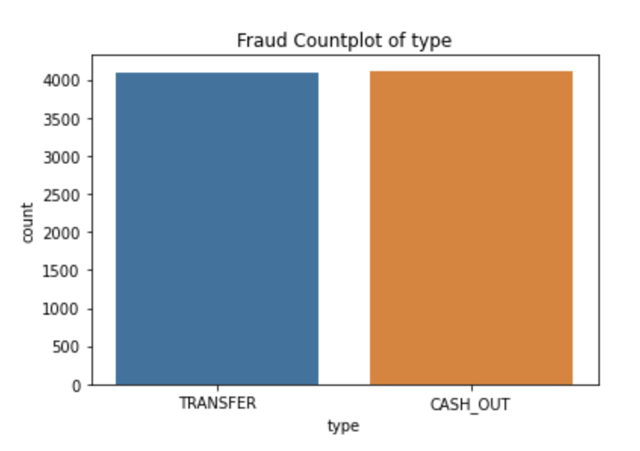
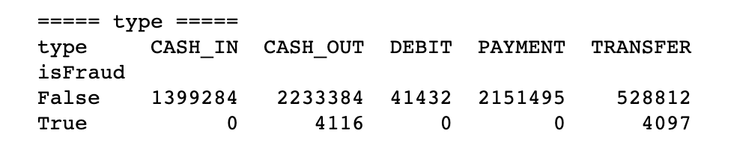
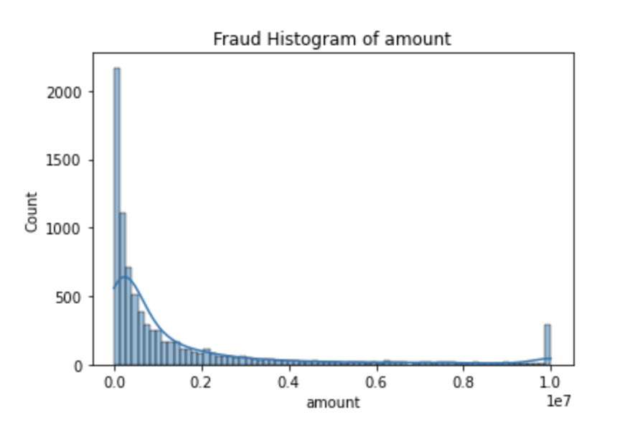
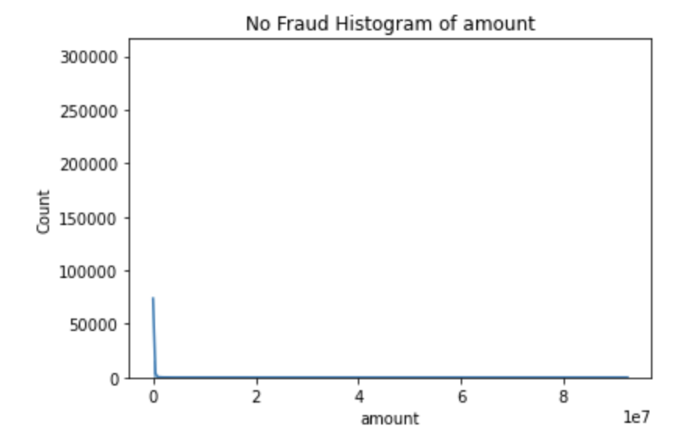
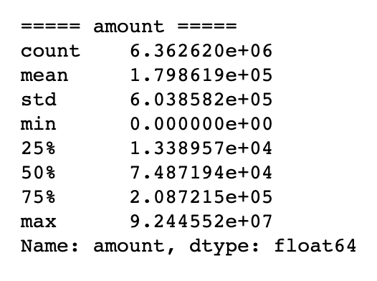
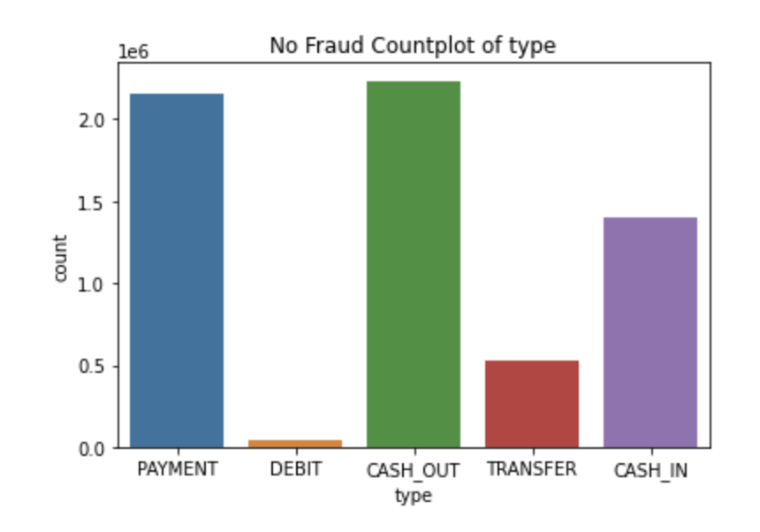
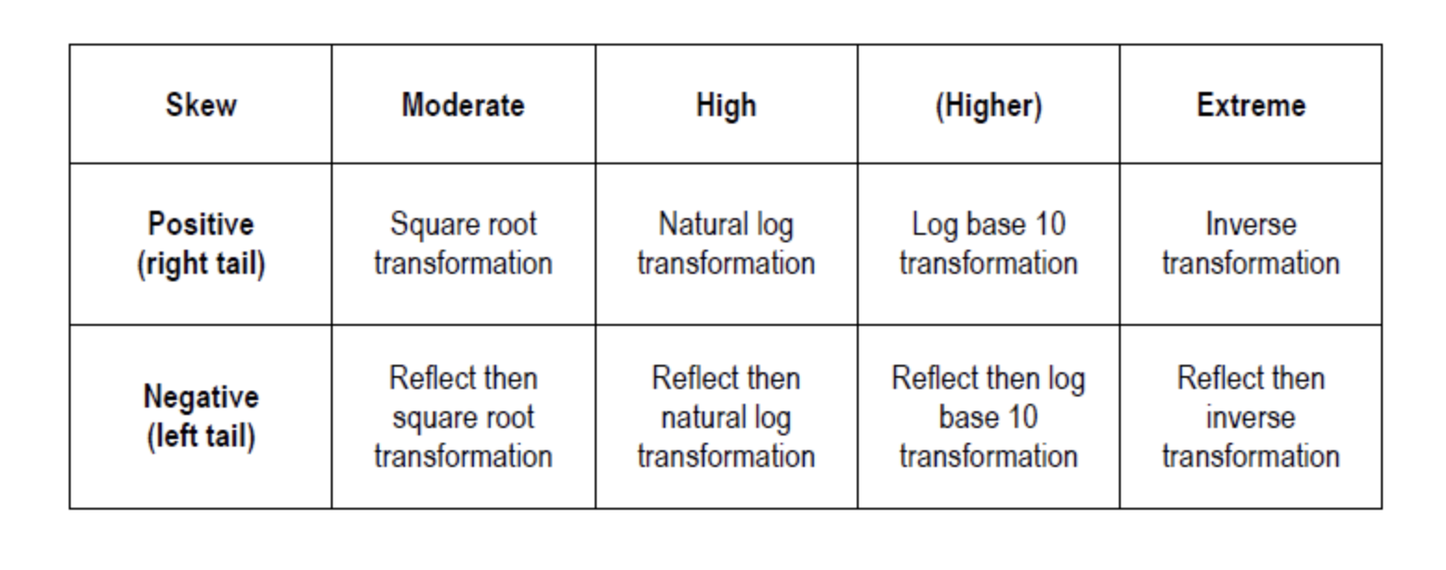
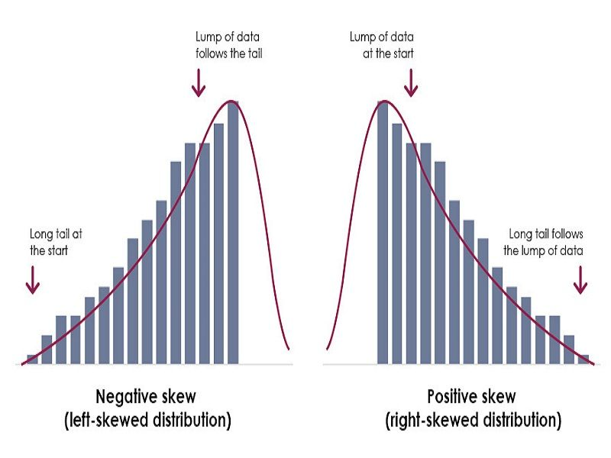
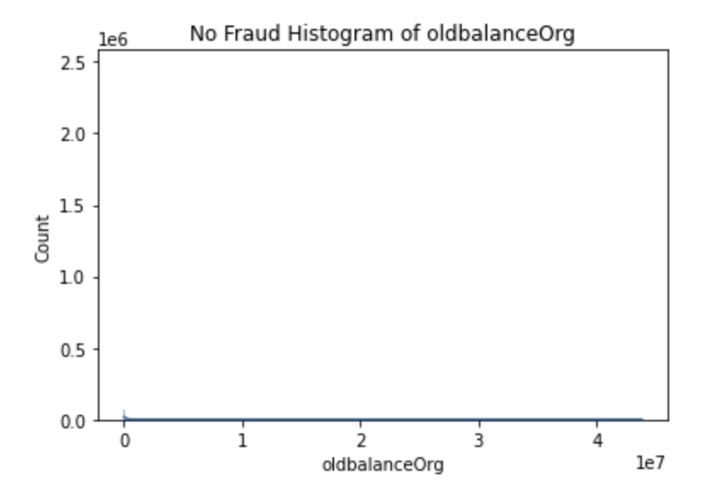
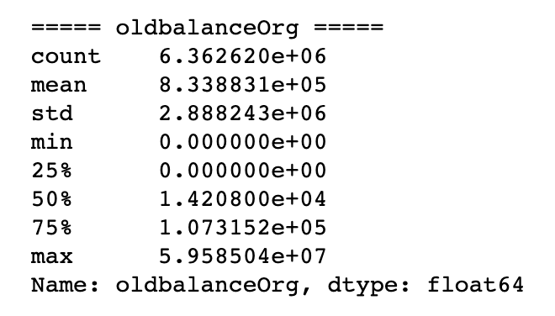
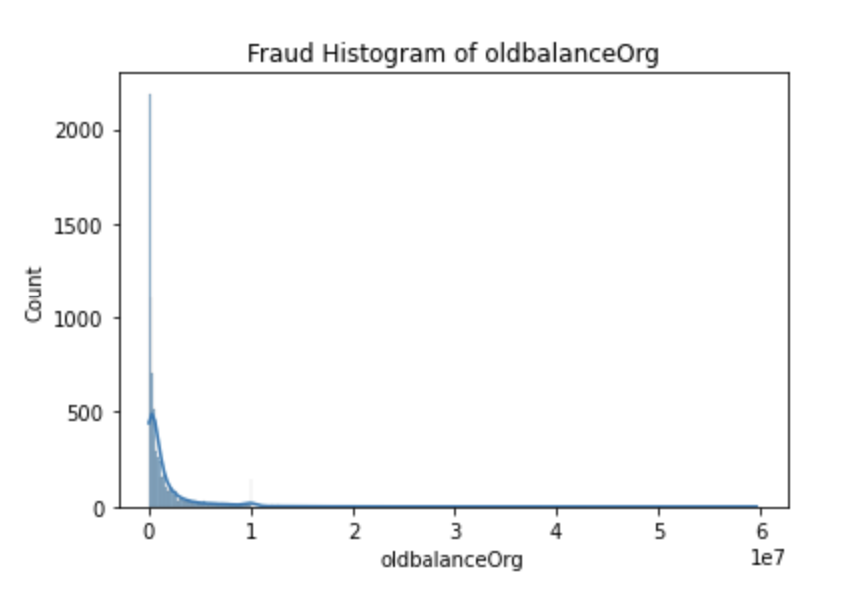
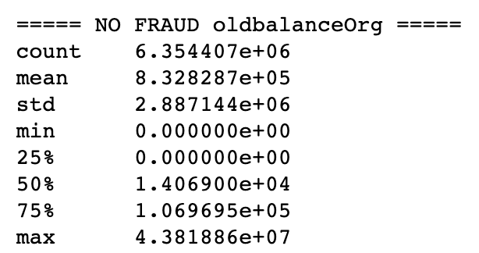
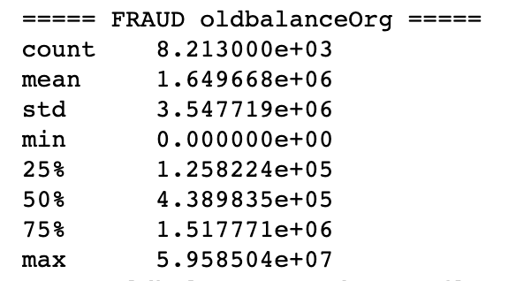

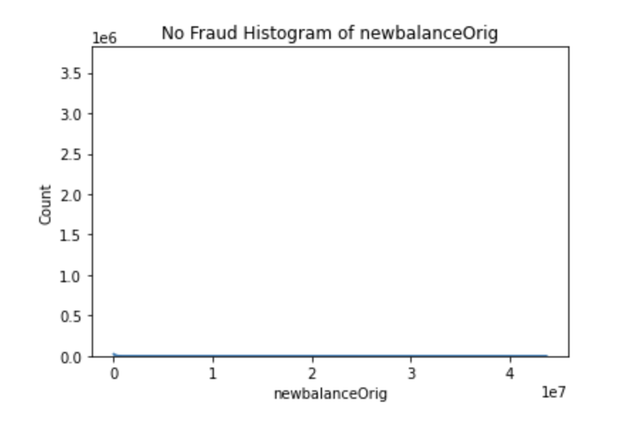
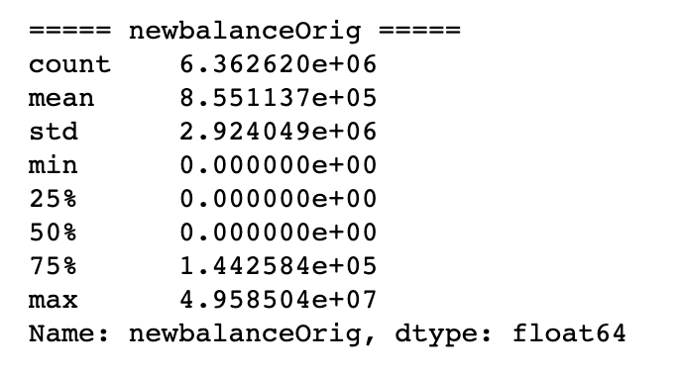
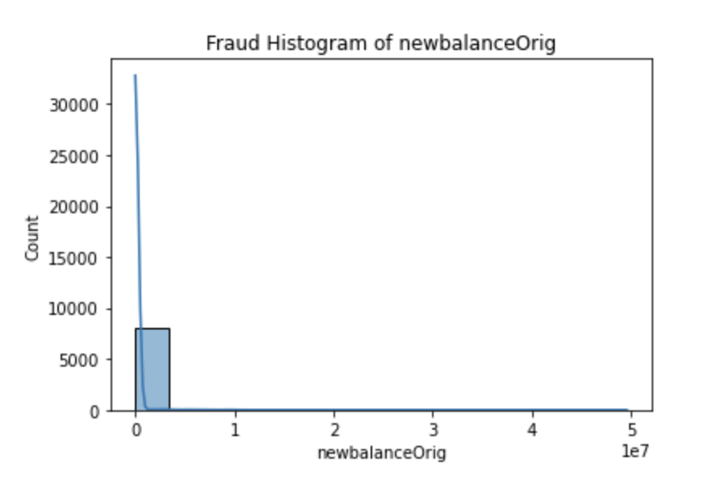
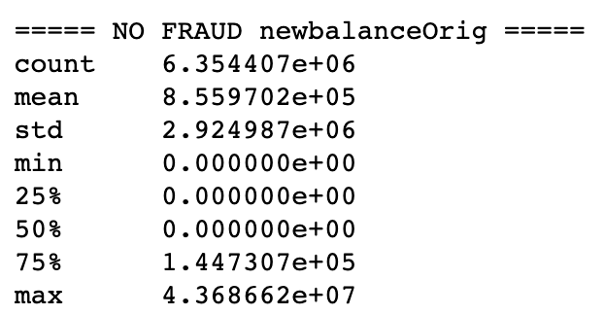
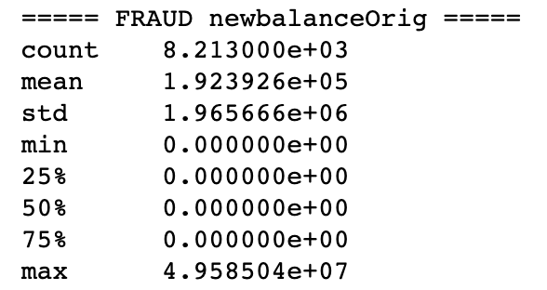
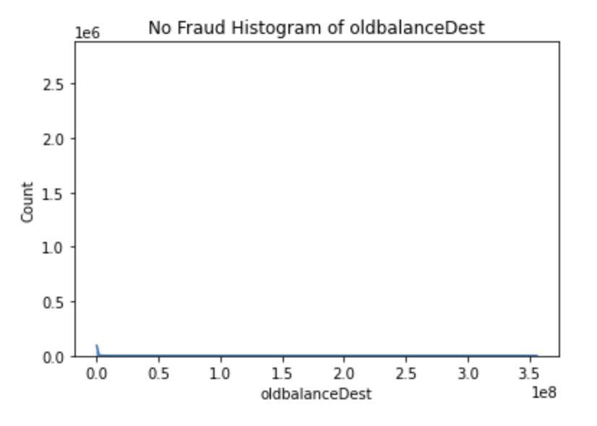
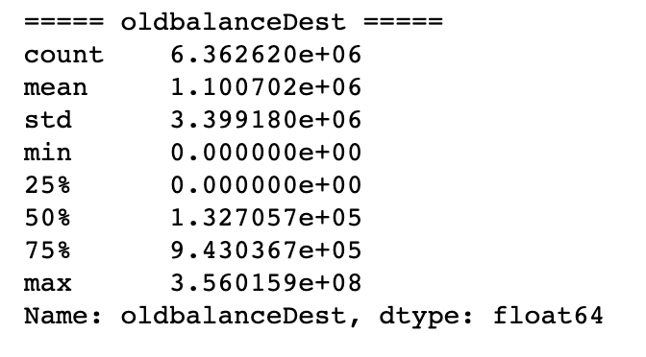
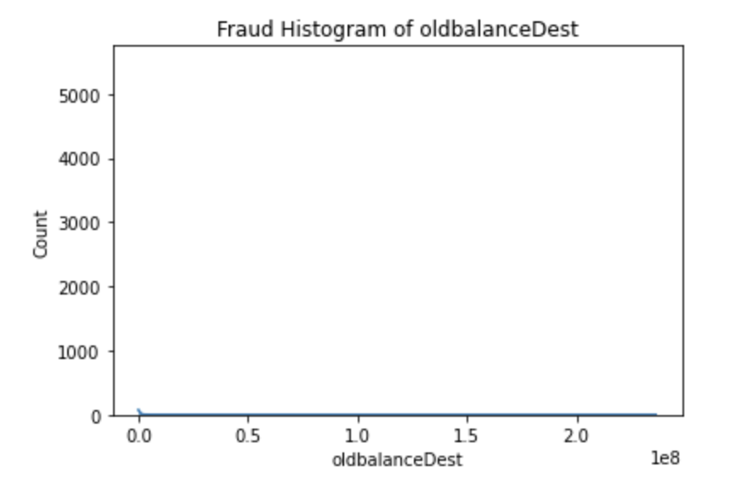
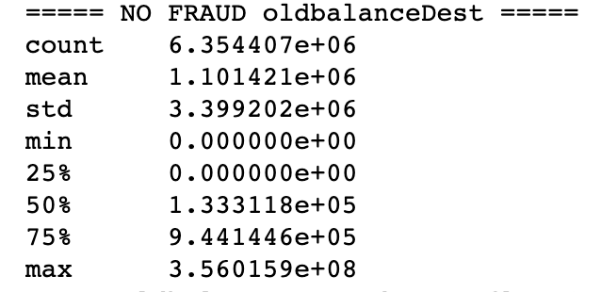
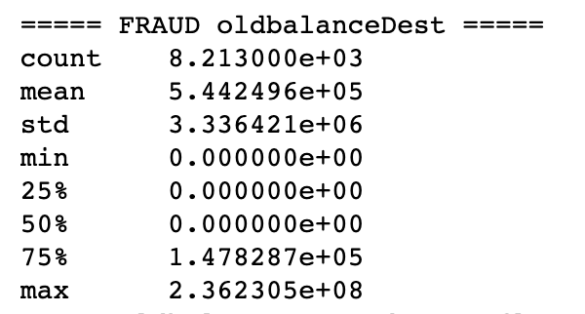
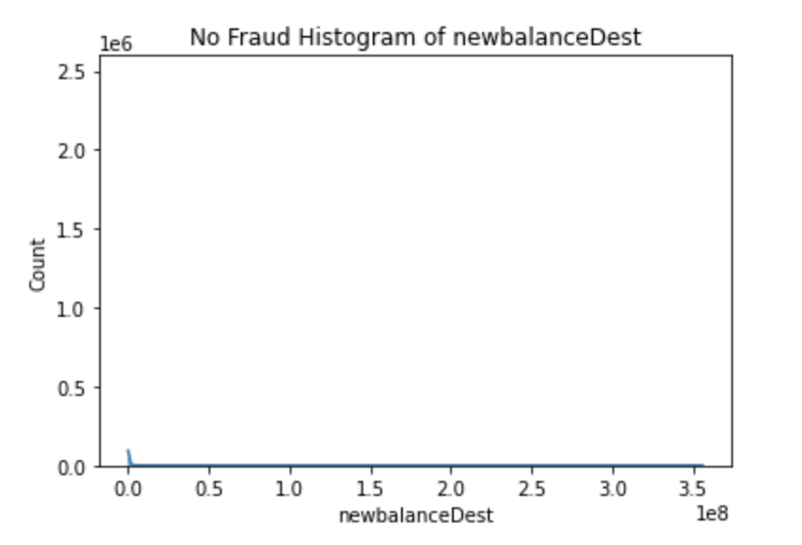
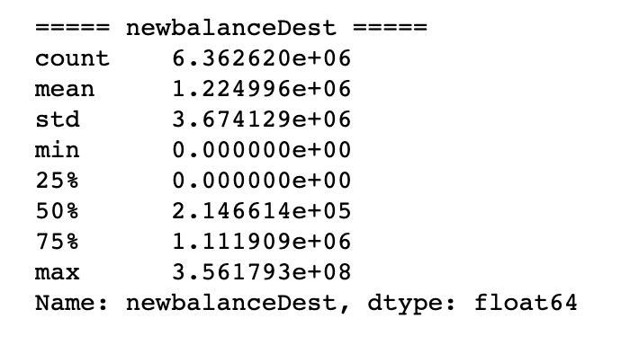

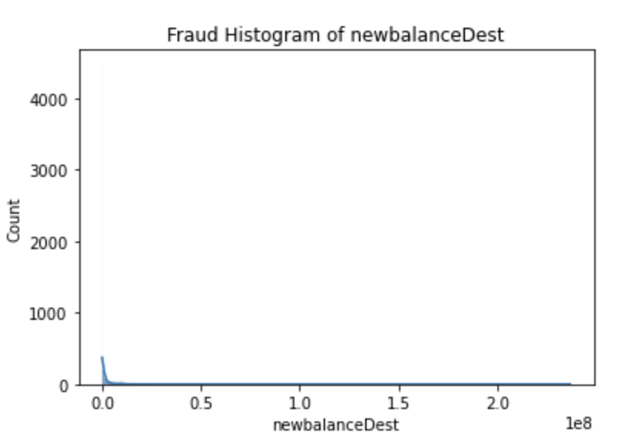
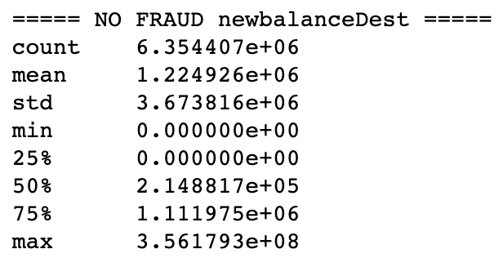
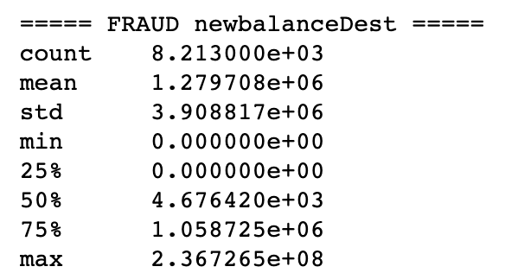
EXPLORATORY DATA ANALYSIS
Python Script: “1.Preliminary Work”
Table 1. Column Summaries from Imported Data
INTRODUCTION
The data is obtained from Kaggle (2nd link). Essentially we are looking at simulated pay data based on real financial data from an African country.
It is 494 MB, so we are unable to check the data in Excel in an effective manner.
There are 11 columns which are summarized in Table 1
There are 6,362,620 rows of data. 6,354,407 (99.8709%) are No Fraud, 8,213 are Fraud (0.1311%) (committed by a fraudulent actor in the simulation).
PYTHON SCRIPT
Import the data using pandas read_csv function. This imports the data as a dataframe from a .csv file.
isFlaggedFraud is dropped because we don’t need to consider this artificial column when trying to predict fraudulent activity.
I created a dictionary object that defines the data types for each of the columns. Most of the data stays the same but I did change the data type for isFraud
I believe I changed this back though later on in the second script, but I will confirm this.
GRAPHS
First I looked at basic histograms (numeric data) and count plots (category). We look at all the data together as well as splitting the data between Fraud and No Fraud.
I also created tables, box plots, and violin plots to better understand the distribution of the data, but to be honest they didn’t really do a better job than the regular distribution charts.
Based on the distributions of the 4 balance variables + amount variable, I can already see that we will have to transform them before inserting into a machine learning algorithm. All of these variables are positively/right – skewed.
See the graphs and distributions for each variable to the right. See below for a good breakdown of the two types of skewedness and the proper numerical transformations for each type.
I took a closer look at the 4 balance variables to better understand their distributions and look at special cases within the data.
For Fraud, many of the original accounts get drained to 0 (about 8012 / 8213). Also about 41 accounts started with 0 which seems to not make sense.
Based on the maximum values, it appears that the people committing fraud can be richer than the people they are stealing from. So its not entirely poorer people stealing from richer people.
For Fraud cases, the original balance of the destination account is greater than the original balance of the original account 17.56% of the time. After the transaction occurs, the new balance of the destination account is greater than the new balance of the original account 50.19% of the time.
For No Fraud cases, the original balance of the destination account is greater than the original balance of the original account 44.26% of the time. After the transaction occurs, the new balance of the destination account is greater than the new balance of the original account 48.7% of the time.
As we can see, the No Fraud percentages are much more comparable with each other, but in the cases of Fraud they are much farther apart.
Then I started to take a look at the name data. The names are structured such that the first character is either a ‘M’ or ‘C’ (merchant or customer) followed by a string of numbers (ID#)
There are 6,353,307 (99.85%) original nameOrig values, but only 2,722,362 (42.79%) original nameDest values. This is because there are a lot of merchants in the data receiving money from customers.
For Fraud, there are no merchants for nameOrig or nameDest. All the merchants are in nameDest under No Fraud.
Then, I checked the data for any missing values. Since this is simulated data based on real life data, there are no missing values. This made the project go by faster because I did not have to take these into account. For real world data, we should not expect this.
What is the point of diving into the data deeper like this? These are important metrics that we should pay attention to when we deploy our machine learning algorithm on real world data. In a real world project, we would probably keep track of distributions and certain metrics (like the % of destination accts > original accts after transactions) to make sure it is still similar to our training data. We can do hypothesis testing to see if our real world data is coming from a different distribution than our training data. If it is, then we should retrain the algorithm on a new set of data.
This completed the basic exploratory data analysis. I saved the data, then moved onto the next script.
Column Name | Initial Data Type | Description
Step | int64 | represents a unit of time where 1 step is 1 hour. There are a total of 744 steps or 30 days. This column was dropped.
Type | object | The type of online transaction. CASH-IN, CASH-OUT, DEBIT, PAYMENT, AND TRANSFER.
Amount | float64 | The amount for the specific transaction.
nameOrig | object | Customer who started the transaction. These are almost all unique values. They start with either C or M, followed by an ID#.
oldbalanceOrg or oldbalanceOrig | float64 | Initial balance before the transaction.
newbalanceOrig | float64 | New balance after the transaction
nameDest | object | Customer who is recipient of transaction. Follows the same pattern as nameOrig.
oldbalanceDest | float64 | Initial balance of recipient before the transaction. If nameDest has an ‘M’ (AKA is a merchant), then this will be blank
newbalanceDest | float64 | New balance of recipient after the transaction. Again, if they are a merchant, this will be blank
isFraud | int64 (Changed to boolean) | Transactions made by fraudsters in the simulation. 1 if Fraud, and 0 if No Fraud. This is the target variable we want the ML algorithm to predict.
isFlaggedFraud | int64 | Whether the business model classified a transaction as Fraud or not. A transaction is flagged if more than $200,000 is attempted to be transferred. This column was dropped
TYPE
AMOUNT
To the left are the count plots of type split by Fraud and No Fraud. Notice the colors between the tables for the categories are different!
Above is the table that shows the count for each category by Fraud or No Fraud.
There are only two transaction types when there is Fraud, but we see all 5 with No Fraud.
If I was working at a company with domain experts, I would double check to make sure this is accurate to real world data, because this will definitely bias our algorithm heavily in the training phase.
Above are histograms of amount split by Fraud and No Fraud. As we can see for both graphs, the data is heavily right-skewed/positively-skewed.
We have a table summarizing basic descriptive stats of all amounts (Fraud and No Fraud). I should have probably broken this out by Fraud and No Fraud like I did for the amount variables, but I didn’t and am too lazy to do that at this point lol.
In both Fraud and No Fraud transactions, we see most of the values are close to 0 AKA they are of low amounts. But there is a very large range of values after that. From the charts we can see that No Fraud has a larger maximum.
We will definitely have to transform the data in order to better approximate a gaussian distribution.
OLDBALANCEORIG
To the left we have a histogram and table for oldbalanceOrig for all No Fraud cases. To the right we have a histogram and table for oldbalanceOrig for all Fraud cases. To the right, we also have a summary table for both cases combined
For both Fraud and No Fraud, we see that the data is heavily positively skewed. There is a concentration of cases near or at 0. It is much harder to see that in the No Fraud histogram, but the table shows us that the value at the 25th percentile is still 0 so we can be confident in our previous statement.
We will have to transform the data before we insert it into an algorithm.
NEWBALANCEORIG
To the left we have a histogram and table for newbalanceOrig for all No Fraud cases. To the right we have a histogram and table for newbalanceOrig for all Fraud cases. Above we have a summary table for both cases combined
For both Fraud and No Fraud, we see that the data is heavily positively skewed. There is a concentration of cases near or at 0. It is much harder to see that in the No Fraud histogram, but the table shows us that the value at the 50th percentile is still 0 so we can be confident in our previous statement.
We will have to transform the data before we insert it into an algorithm.
OLDBALANCEDEST
To the left we have a histogram and table for oldbalanceDest for all No Fraud cases. To the right we have a histogram and table for oldbalanceDest for all Fraud cases. To the right, we also have a summary table for both cases combined
For both Fraud and No Fraud, we see that the data is heavily positively skewed. There is a concentration of cases near or at 0. It is much harder to see that in the No Fraud histogram, but the table shows us that the value at the 25th percentile is still 0 so we can be confident in our previous statement.
We will have to transform the data before we insert it into an algorithm.
NEWBALANCEDEST
To the left we have a histogram and table for newbalanceDest for all No Fraud cases. To the right we have a histogram and table for newbalanceDest for all Fraud cases. Above we have a summary table for both cases combined
For both Fraud and No Fraud, we see that the data is heavily positively skewed. There is a concentration of cases near or at 0. It is much harder to see that in the No Fraud histogram, but the table shows us that the value at the 25th percentile is still 0 so we can be confident in our previous statement.
We will have to transform the data before we insert it into an algorithm.

Slide 3

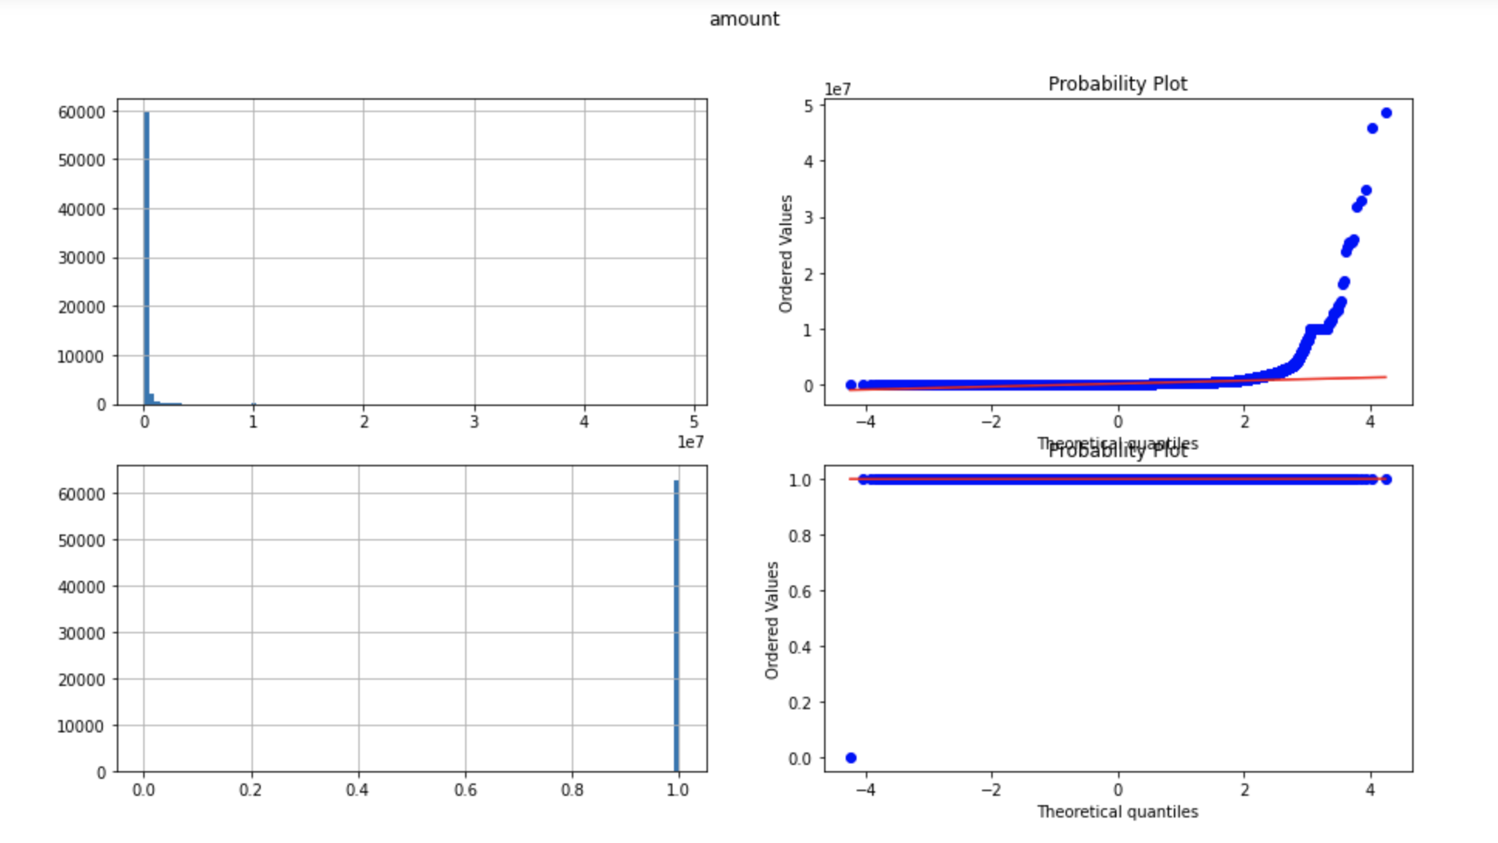
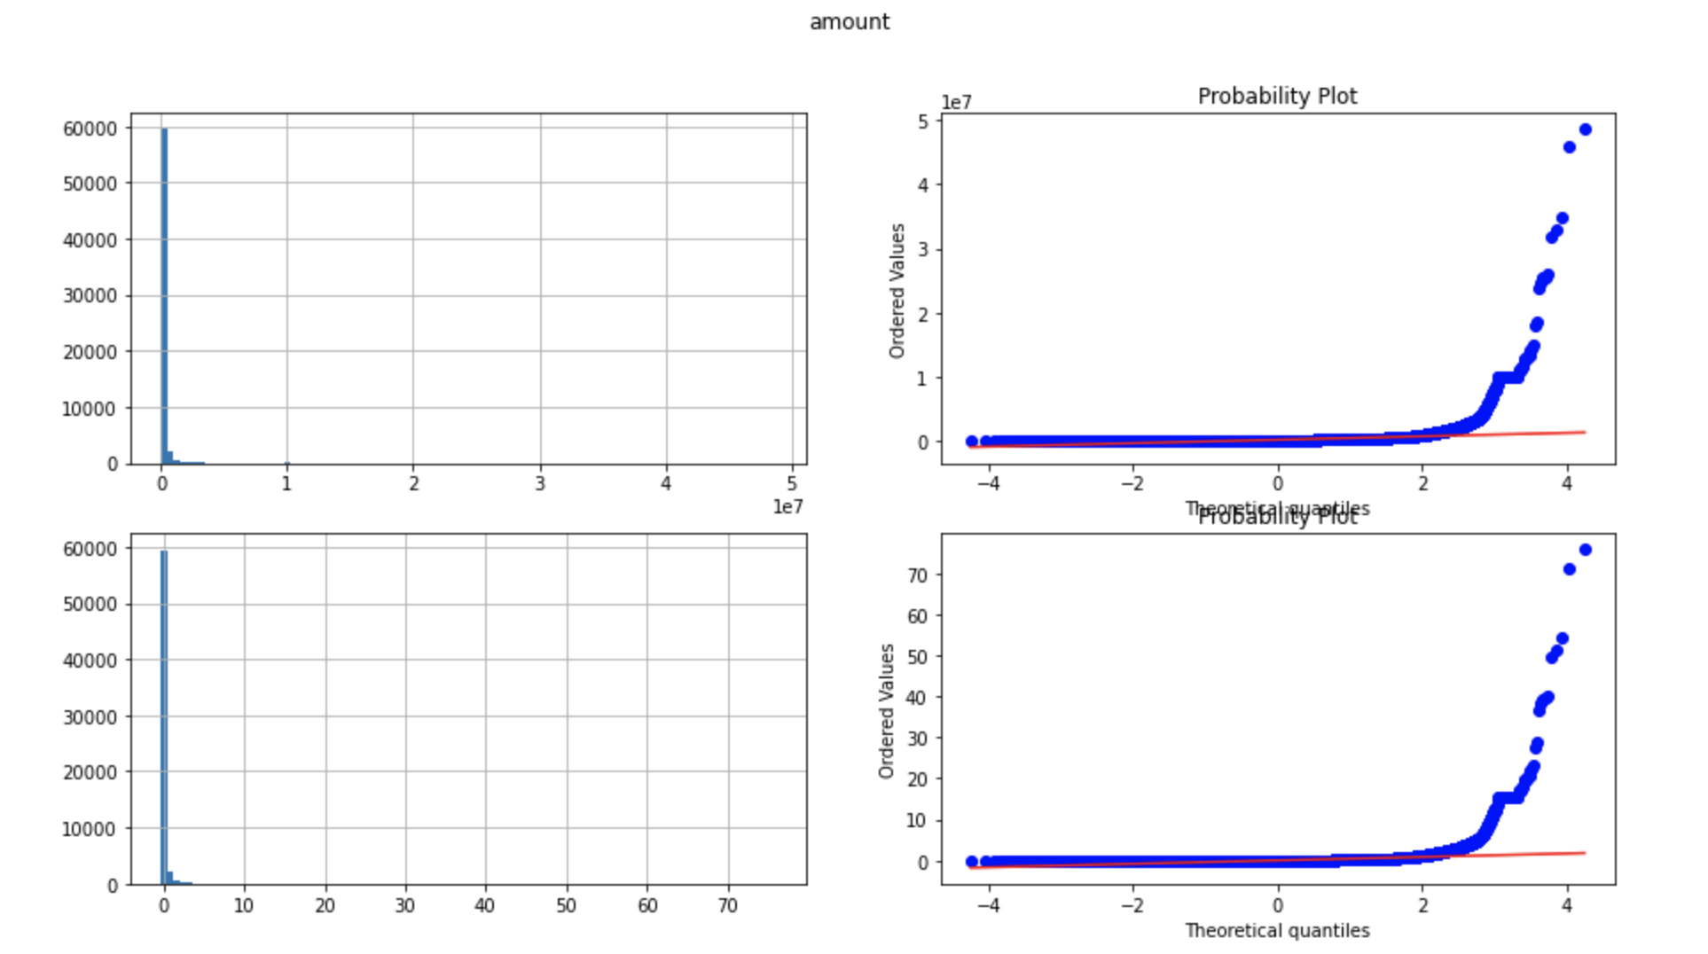
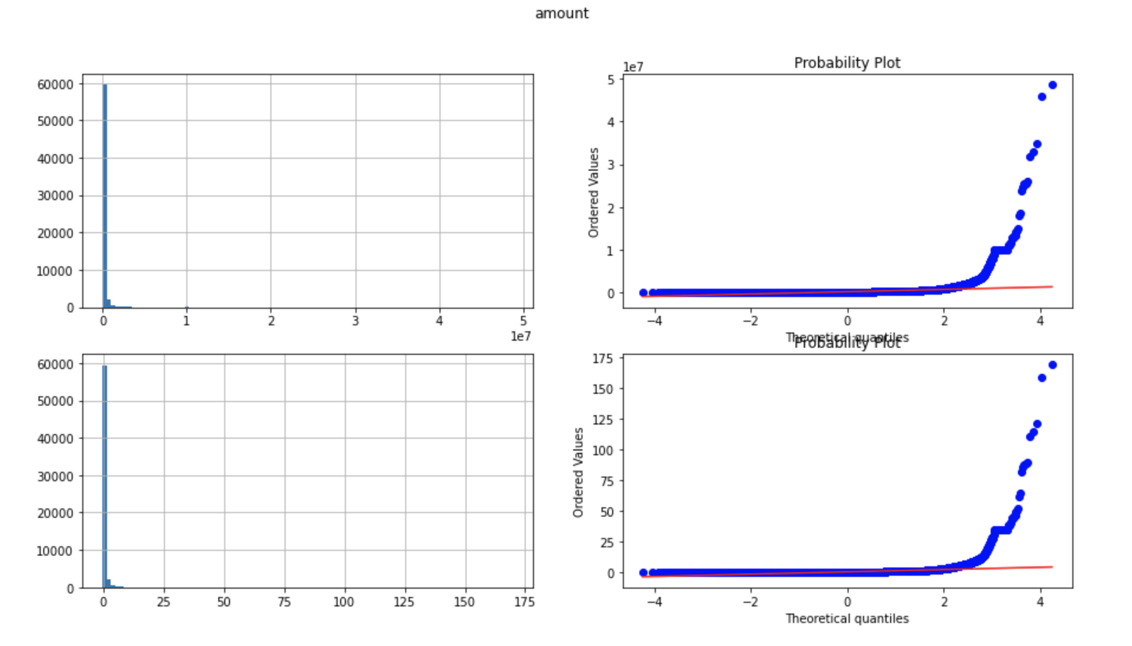
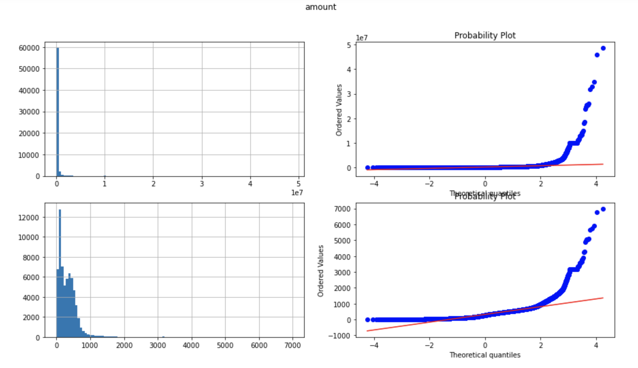
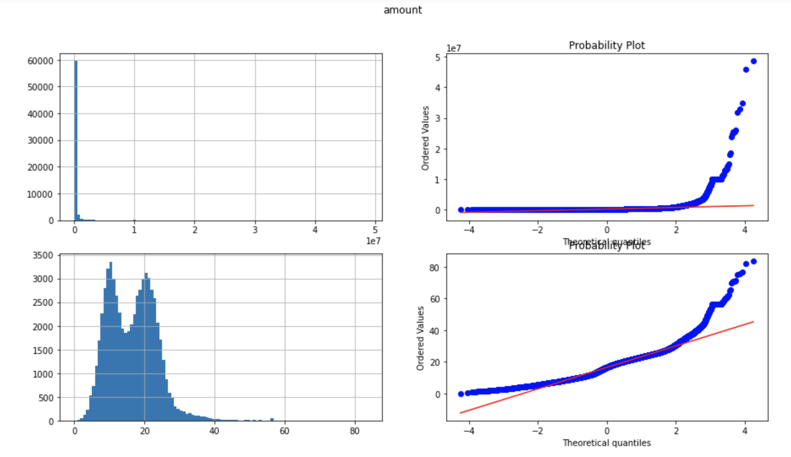
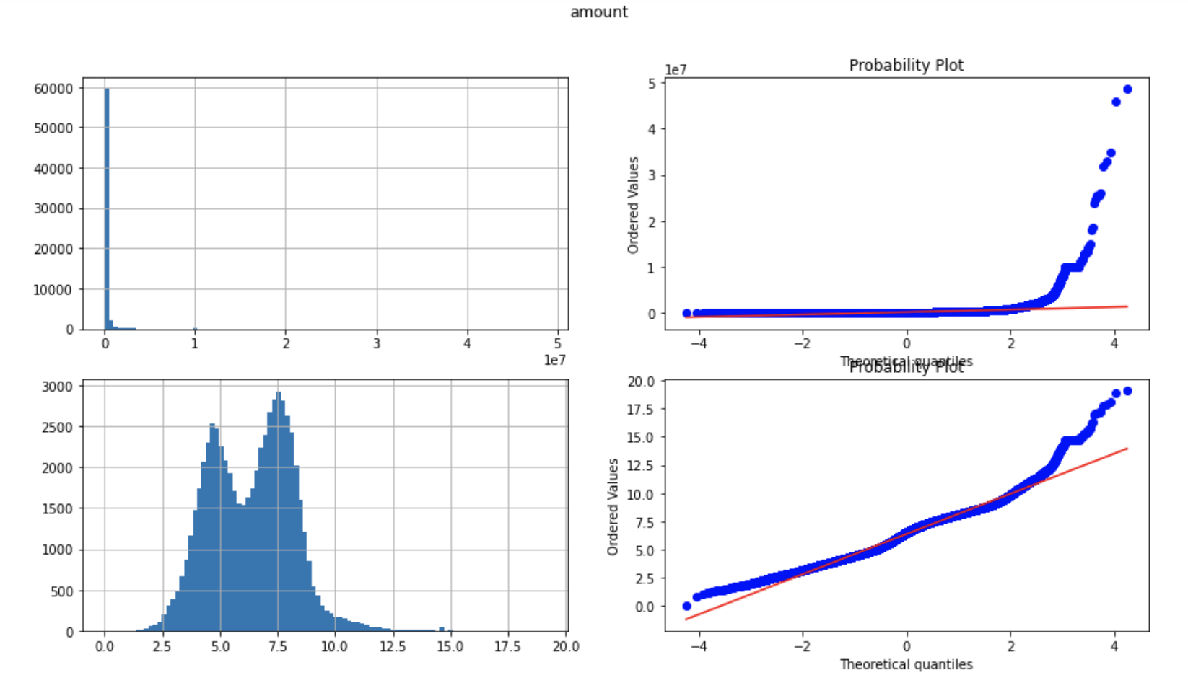
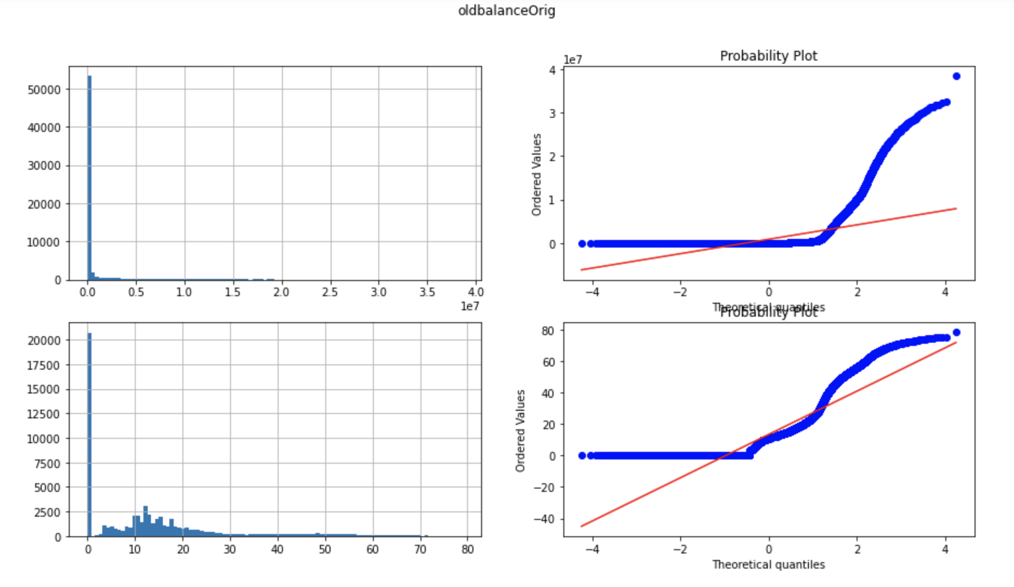
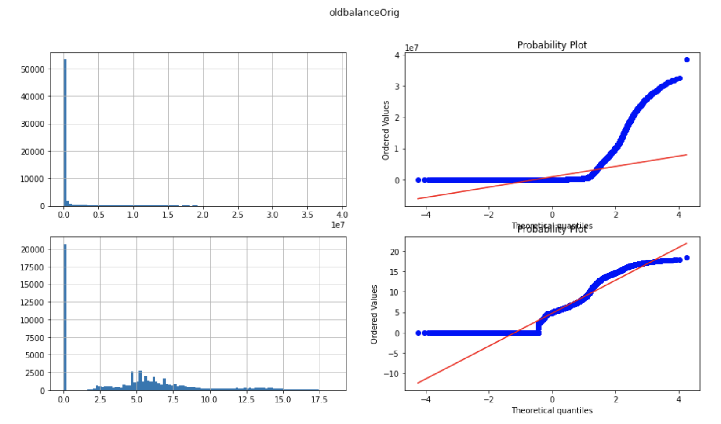
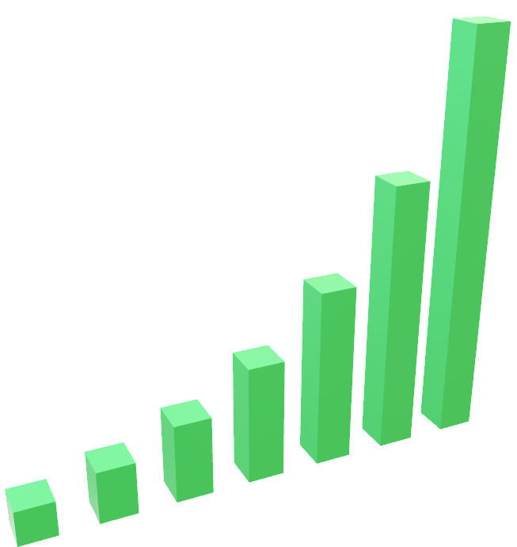
PROCESSING DATA
Python Script: “2.Processing Data”
1. SPLIT THE DATA
We will split the data according to the Course 2 of the deeplearning.ai course on coursera.
Traditionally, we split the data into train and test sets by a 70/ 30 split. This kind of split works well for datasets in the 100/ 1000/ 10000 range.
As we get more data, however, we can use lower %’s because we still only need the same # of data points to test our ML algorithms. i.e. 30% of 30,000 is about 9,000 data points. 1% of 1,000,000 is about 10,000 data points.
The more data points we can get for training while still having a sizable amount for the testing set, the better!
In the case of this dataset, I did a 99 train / 1 test split.
Size of training data: 6,298,993
Fraud vs No Fraud: 6,290,867 vs 8,126
Size of testing data: 63,627
Fraud vs No Fraud: 63,540 vs 87
INTRODUCTION
After some exploratory data analysis, we are ready to start processing our data!
Based on paper’s I’ve read and the artemis youtube video, the general pre-processing method should follow these steps:
Split data into train and test sets. The size of the datasets determines the split percentages (see deeplearning.ai notes from coursera.com).
Address missing data. Depending if the data is “missing completely at random”, “missing at random”, or “missing not at random” will determine how we fill those values in.
Transform data and/or Feature Engineering!
For numerical data this means normalizing, standardizing, or applying some type of transformation to make the distribution more Gaussian. This is where we handle outliers as well.
We encode categorical data. One-hot encoding is the preferred method, but there are more advanced methods.
We extract more information from date variables. We do not treat them like categorical or numerical data. Try to grab month, day of week, year, etc. information to help put into context what that date means.
Feature engineering! Think of more efficient ways to represent certain features to make it easier for algorithm to pick up patterns (at least that’s how I understand it).
Data reduction! Apply Tomek Links for classification problems. You can also randomly under-sample the data if you have a large dataset, which works for classification and regression problems
Feature selection. Determine which features we should keep and which ones to remove.
For this project, the format we follow is: 1. Split the data into train and test sets, 2. Transform the data, 3. Apply tomek links (and random under-sampling to majority class) to reduce the dataset.
2. TRANSFORM THE DATA
Now we are ready to transform the data. I broke out the data into numerical and categorical sets:
Numerical data: amount, oldbalanceOrig, newbalanceOrig, oldbalanceDest, newbalanceDest
Categorical data: step, type, nameOrig, nameDest
NUMERICAL DATA
We establish that the numerical data is highly positively skewed from the previous slide. Because of this, we need to try multiple transformations.
We want a transformation that makes the data closer to a Gaussian distribution. See below for graphs of the amount variable that are examples of the different transformations that I looked at.
There are four plots in a 2x2 formation. The first two plots at the top are the regular, untouched data. We have a histogram on the left and a probability plot on the right. The probability plot shows us how well our data aligns with the shape of a Gaussian distribution; the more we align with the red line in the plot, the better! The bottom two plots are a histogram and probability plot of the transformed data.
I ended up choosing the 4-root transformation for the numerical data. You can’t see with the amount graphs, but as we increased the root for the other four numerical variables, a straight line in the probability plot gets more prominent and less aligned with the red line. You can see it in the smaller graphs below the Functions Explained text box. Because of this phenomena, I chose the 4-root transformation as the best transformation.
I did the same transformation to all of these numerical variables because I wanted them to all be on the same scale because they are related to each other. I could’ve done a larger root value for the amount variable since it was helping the distribution become more Gaussian, but I figured it would be best to keep them all on the same scale. (Added 11/27/23)
I created new columns for these transformed values, and dropped the original values from the dataset.
CATEGORICAL DATA
I dropped the step variable since I only had one month worth of data, I figured the time variable wouldn’t be that important since we are only looking at a month’s worth of data. If I had a year or several years worth of data, I would have converted it to hours, days, day of week, month, year, etc.
type
I one-hot encoded this variable. I created four columns for the five different values in the column. They are boolean columns, so when all columns are 0, that represents the 5th value.
nameOrig or nameDest
I couldn’t one-hot encode this variable because there are so many values. So what I did is I created two columns for each of the name variables: 1.) one column that signifies whether the first letter is a ’C’ or ‘M’, and 2.) one column that tells us if the ID# repeats itself in the data. Therefore we will add a total of 4 columns to the data.
First, we create new variables for each name variable and convert them to a list. This helps us do the operations we want to do on the variables later.
Next, we create two new variables. The first variable has the first letter for each entry, and the second variable stores the following ID#.
Using the first variable, I create a new boolean variable where we give a 1 if the letter is a ‘C’ and a 0 if the letter is a ‘M’. I chose this way because there are more C’s than M’s, and we want the variable to have more 1’s than 0’s. We add this variable to the dataframe. These variables are called ClientOrig and ClientDest.
I add the second variable to the dataframe because we need to in order to use ”value_counts” in the next step.
We use value_counts to create a table of all the ID #’s and counts of how many times they appear in the data. We grab the ID #’s using index because the iD #’s are the indices of the value count table. Then I find all ID #’s that have counts >1.
We create a new column that is a boolean. If the ID repeats, then we give a 0, otherwise we get a 1. Again, this is because there are much more unique ID’s and we want the data to have more 1’s than 0’s.
We drop the ID# and original name variable. We add this new boolean variable that looks at unique ID #’s and we have completed converting the name variables! These variables are called NO_ID_unique (NO = Name Orig) and ND_ID_unique (ND = Name Dest).
For each of these categorical variables, I dropped the original columns are creating the new transformed columns
NORMALIZED
STANDARDIZED
ROBUST SCALER
FUNCTIONS EXPLAINED
diagnostic_plots
Inputs: df, var, trans
df is the dataframe with the data, var is the variable that we want to look at, and trans is the type of transformation we are doing on the data (normal, robust, or standard)
First we figure out the type of transformation we are doing on the data. For a normal transform, we can do a standard normal.fit_transform. For standard and robust, we have to rearrange the data with to_numpy and reshape in order for fit_transform to take the data.
Then we convert the transformed variable into a pd.Series so we can create the histogram. The next line essentially turns this series of nested lists into a clean list of values that we can graph.
Then we plot the four plots in a 2x2 grid. First two graphs on top are the histogram and probability plot of the regular variable. The bottom two graphs are the histogram and probability plot of the transformed variable.
dp_root
Inputs: df, var, root
df is the dataframe with the data, var is the variable that we want to look at, and root is the type of root transformation we are doing on the data.
First we transform the numerical data by the root we give to the function.
Then we do a similar 2x2 grid plot that we did above. The regular data histogram and probability plot are at the top, and the transformed data histogram and probability plot are at the bottom.
I did not use the other two functions because they did not work. They did not work because of the 0’s in the data. We could have used them if we handled the 0’s by setting them to other values or removing them completely.
SQUARE ROOT
FOUR ROOT
SIX ROOT
Four Root vs Six Root (oldbalanceOrig)

Slide 4

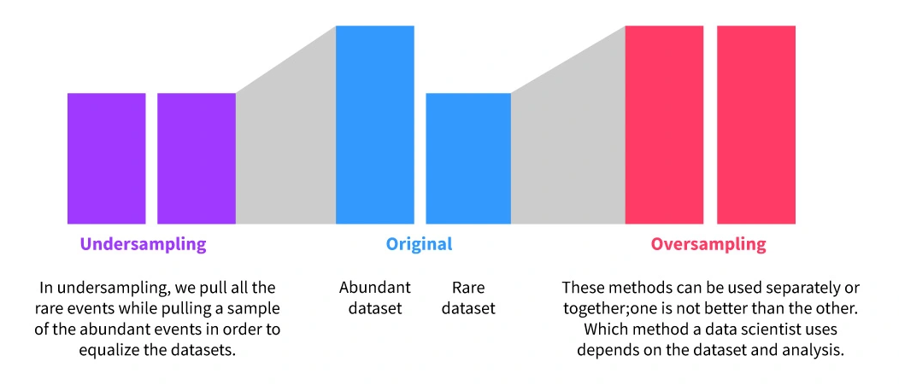

PROCESSING DATA
3. REDUCE THE DATA
There are many ways to reduce the dataset to make it easier for machine learning algorithms to learn the relationships in the data.
Two ways that we are going to look at for the project are 1.) Tomek Links, and 2.) Random Under-Sampling.
TOMEK LINKS
Tomek Links are typically used in classification problems (binary or multiple classes) where there is a class imbalance.
The class with more points is known as the majority class and the other class(es) is/are known as the minority class(es).
A dataset has N feature variables (x) that are supposed to help us predict the class variable (y).
Essentially, we plot the data in N-dimensional space, and we “color” the points depending on their class.
Primarily, we are focusing on edge cases where these points of different classes are close to each other. These edge cases are called Tomek Links.
We remove the points that are from the majority class (for binary classification problems) so the machine learning algorithm learns patterns in the data better.
RANDOM UNDER-SAMPLING
Again this is primarily used for classification problems.
This is used for class imbalances where we have a majority and minority class.
We tell the algorithm which class is the majority class, and then it randomly samples the data. BUT, it makes sure to under sample from the majority class so the class balances are more even before we input it into the algorithm.
We want under-sampling instead of over-sampling because there is such a large discrepancy between the classes (99.9% - 0.1%). If we over-sample the minority class, we are going to end up with A LOT of duplicate values which may negatively affect the ML algorithm training process.
Here is a special link that explains this method better.
DATASET
I created two datasets from the training data
I removed Tomek Links from the training data. This is the first dataset. This dataset has 6,298,278 rows. It will be called the tomek dataset.
I then randomly undersampled this first dataset and created the second dataset. This dataset has 16,252 rows. It will be called the rus+tomek dataset.
Now we are ready to start having some fun with the data!
TOMEK LINK EXAMPLE
RANDOM UNDERSAMPLING AND OVERSAMPLING

Slide 5
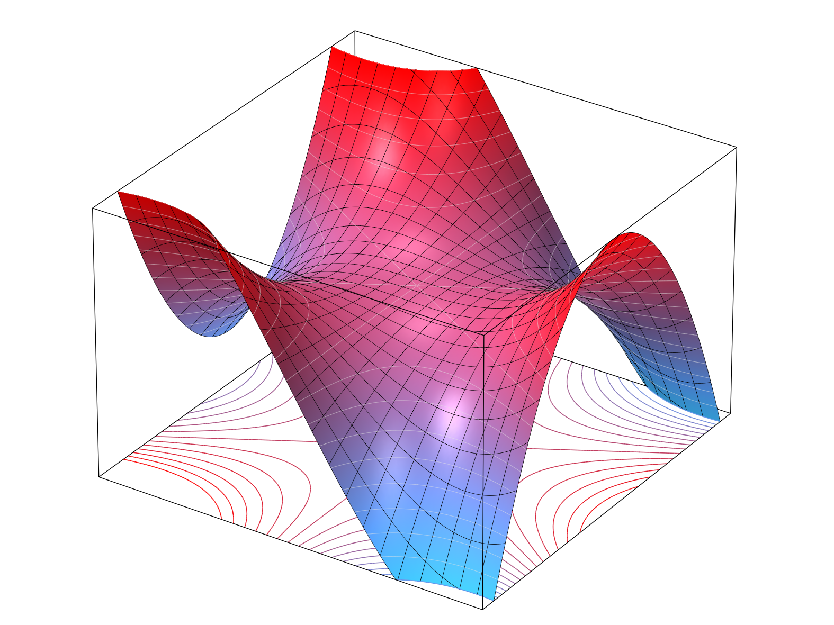
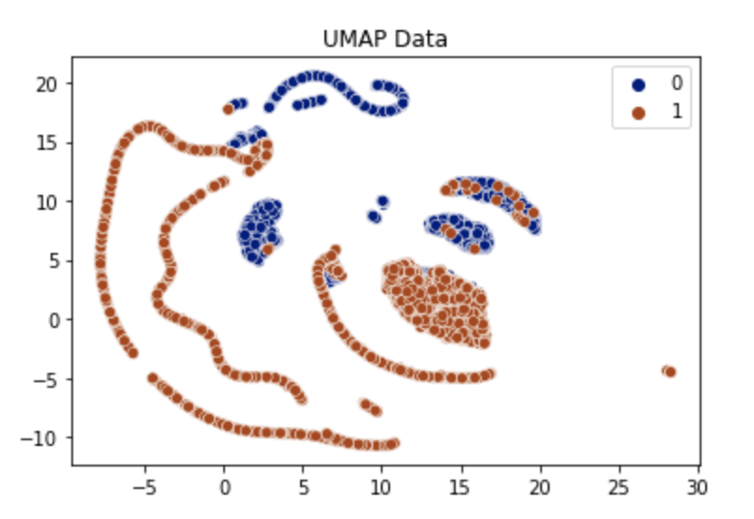
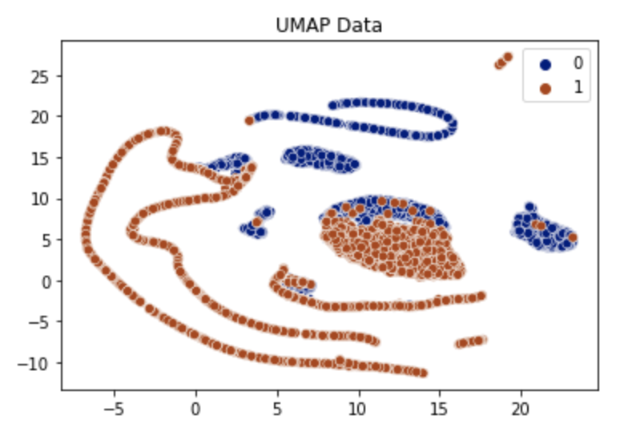
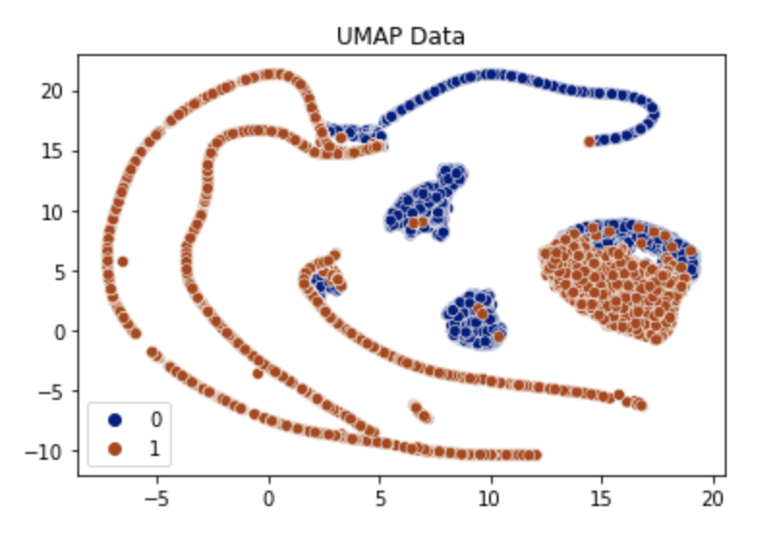
UNIFORM MANIFOLD APPROXIMATION & PROJECTION
Python Script: “3.UMAP”
Before we input the data into a machine learning algorithm, we want to try and see what the data “looks like” to get an idea of what we’re working with. We can use UMAP to do this for data with high dimensionality (>3). It is typically used for unsupervised problems because we don’t know what the columns mean in the first place.
In the artemis youtube video, he explains you may want to use this technique to help explain/summarize the data to shareholders.
UMAP is defined as a dimension reduction technique that can be used for visualization similarly to t-SNE, but also for general non-linear dimension reduction.
Without getting into too much detail (the details are in my OneNote notes), UMAP essentially looks at the data in the original higher-dimensional form, and uses topology to map it into lower dimensions while keeping a lot of its ”inherent” global structure.
There are 4 primary hyperparameters for this function:
n_neighbors - the “neighborhood” size to use for local metric approximation. This is the number of data points that is defined as a local neighborhood in the topological calculations.
d (n_components) – the dimension of the target reduced space. In this case we want to reduce to 2 dimensions, which is the default.
min-dist – The desired separation between close points in the embedding space. Essentially, this is the desired distance between points when we project them into 2D.
n-epochs – Controls the amount of optimization work to perform. This is the number of epochs to optimize the representation in 2D.
Metric – This parameter specifies how we compute the distance. Typically, we use euclidean distance. You shouldn’t use any other metric unless you have a strong theoretical basis for doing so.
I was not able to use UMAP for the tomek dataset because the dataset was so large, but I was able to use it for the rus+tomek dataset.
Below are the graphs that I created using UMAP, where I varied n and min-dist.
I was not able to fully understand what I was looking at, but we can see there is some clear delineation between Fraud (1/orange), and No Fraud (0/blue).
Because this is the rus+tomek dataset, the # of Fraud and No Fraud data points are closer to being equal.
Based on these visuals, we can see that there are differences between Fraud and No Fraud, and we should expect a machine learning algorithm to be able to tell the difference between these two classifications in the higher dimensional space.
Figure 1. UMAP projection of rus+tomek data with min_dist = 0, and n_neighbors = 70
Figure 2. UMAP projection of rus+tomek data with min_dist = 0.1, and n_neighbors = 70
Figure 3. UMAP projection of rus+tomek data with min_dist = 0.1, and n_neighbors = 150

Slide 6
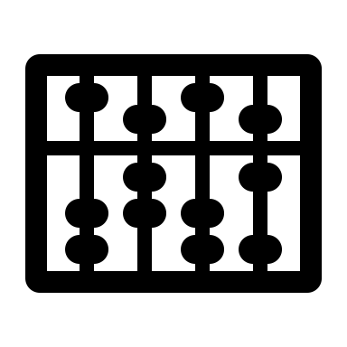


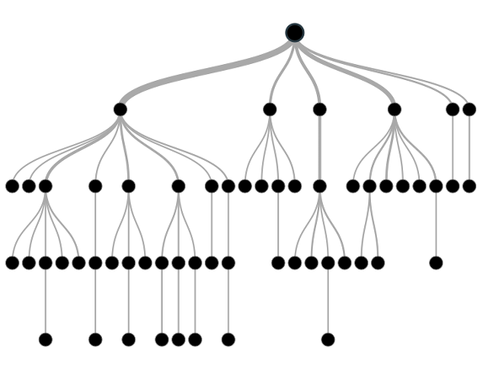
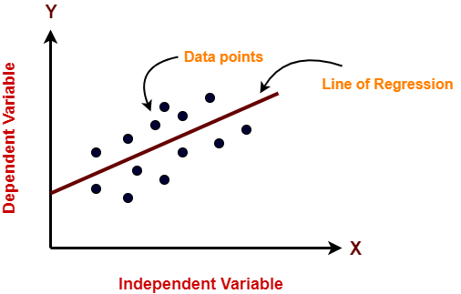
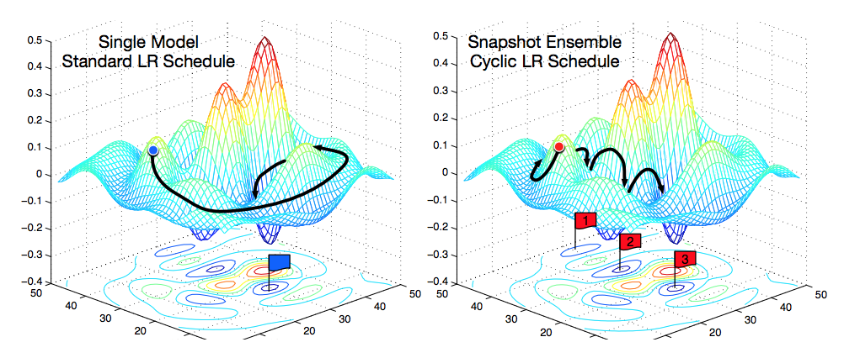
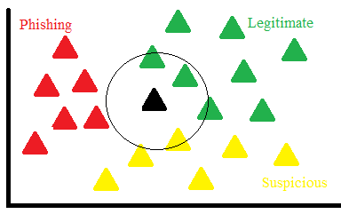
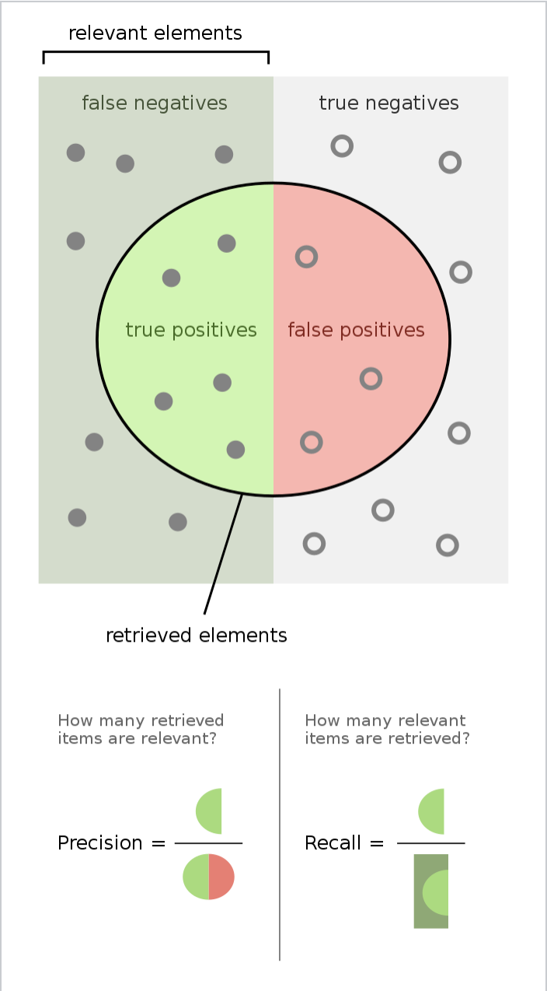
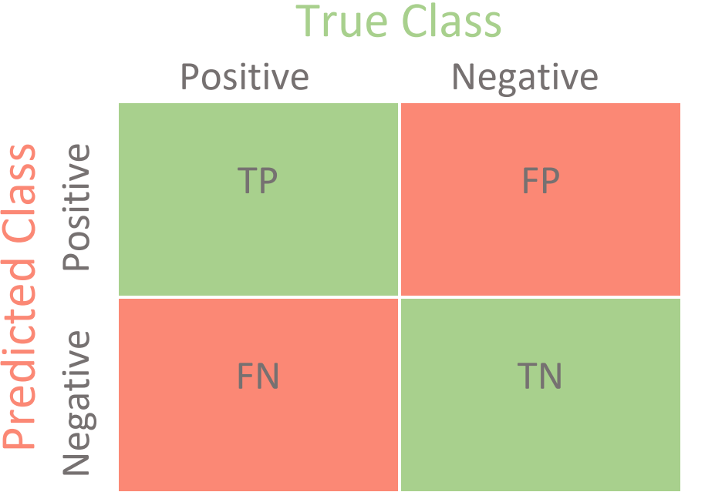
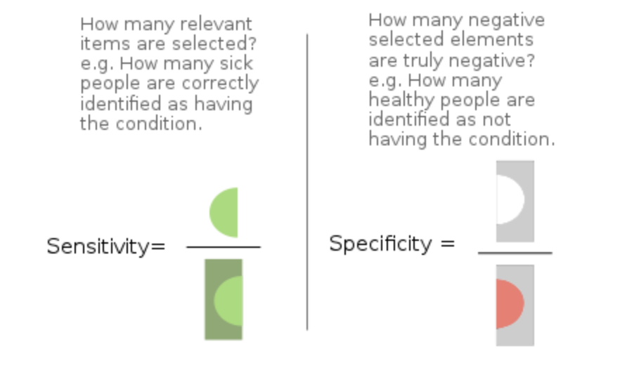
MODELING THE DATA
Python Script: “4. Modeling”
INTRODUCTION
Before we get into the modeling aspect of the project, there were 3 things that we need to figure out: 1.) Establish the set of machine learning algorithms we want to test on the datasets, 2.) Determine metrics to look at that would define a ”good” algorithm, and 3.) Develop a framework/pipeline to run the code efficiently.
1. MACHINE LEARNING ALGORITHMS
We want to focus on classifier algorithms since this is a classification problem. Based on algorithms in the artemis youtube video and other algorithms I heard about, these were the algorithms that I chose to look at:
TREE ALGORITHMS - These are all decision tree-based algorithm that is composed of decision nodes and leaf nodes. These decision trees are essentially comprised of different logical statements specific features in order to split the data into subsets and determine which class a specific instance belongs to. Whichever leaf node an instance belongs to determines the class. All these algorithms implement this basic idea in different ways.
Decision Tree Classifier: The most basic tree-based algorithm. This is a single decision tree.
Extra Tree Classifier: This classifier is a step-up to the regular decision tree. Essentially, at each node features are randomly sampled from the dataset based on the max_features variable and it will randomly choose a variable and value at which to split the data on. This should not be used by itself, It should be used in an ensemble algorithm. Which leads to the next algorithm…
Extra Trees Classifier: This algorithm fits a number of randomized decision trees (AKA extra trees) on various sub samples of the dataset. This algorithm then uses averaging between all the trees in order to increase predictive accuracy and prevent over-fitting. This is similar to the random forest algorithm, but the trees are developed randomly. Here is an article that explains the differences between ETC and RFC.
Random Forest Classifier: The random forest algorithm is an ensemble method that uses multiple trees like the extra trees classifier. However, the trees are not randomly generated from random samples and splits from the data. Instead we use a method known as “bagging” AKA bootstrap aggregating. Essentially, this randomly samples the data with replacement, and it trains decision trees with these different random samples. However, the values of the features for the split are not chosen randomly; these are chosen with another algorithm to help determine an optimal split for that particular feature. All of these decision trees are then utilized to help make a decision on a new piece of data.
Gradient Boosting Classifier : Gradient boosting is a specific machine learning technique. We have a loss function that captures the error in our predictions that we want to minimize. In order to minimize this function, gradient boosting acts by iteratively adding weak learners together. A weak learner is a single decision tree that doesn’t do well at classifying the data. But as we add more together, we can create an ensemble of learning algorithms that can do pretty well at classifying the data (depending on how we tune the hyperpararmeters of course).
Extreme Gradient Boosted Machine (XGBoost): This algorithm has the same basic premise described above. The only difference is the various optimization methods this algorithm uses to minimize the loss function that is used. Note that this algorithm takes a LONG TIME to execute. When I was running my code, this algorithm by far took the longest to run compared to the rest.
Light Gradient Boosted Machine (LGBM): This algorithm also uses the general gradient boosting technique, but again implements it in a different way. According to this article, LGBM uses histograms to bin the data and make the calculations more efficient. It also combines some features together to reduce the feature space and make the algorithm run faster.
LINEAR ALGORITHMS - These algorithms develop an equation based on the feature variables. Depending on the output of this equation, this helps us classify a specific instance as part of certain class.
Logistic Regression: This algorithm is very similar to a linear regression equation, except we use a logarithmic equation instead, and the output is binary (0 or 1).
Ridge Classifier: This algorithm uses a linear regression equation, but it imposes an extra coefficient to penalize large coefficients. This is called the regularization coefficient, and typically helps the algorithm learn better.
Stochastic Gradient Descent Classifier: This algorithm uses a technique known as gradient descent. Gradient descent works by essentially working to minimize the cost function (related to the error in the prediction) by taking the derivative of this function to correct the weights of the algorithm. The idea being that we do this process enough to find the weights of that perfectly minimize the cost function. Interestingly enough, this is simply a method and not necessarily associated with a specific class of algorithms. We specify the type of algorithm as one of the parameters. In this case, the default is a linear support vector machine (SVM)
OTHER ALGORITHMS- These algorithms use different methods to classify the data.
K-Nearest Neighbor: We plot the data in a N-dimensional space and group the points that are close together. The class is determined by the class of the majority number of points around the point we are making a prediction on.
Gaussian Naïve Bayes & Multinominal Naïve Bayes: Both Naïve Bayes algorithms use the Naïve Bayes probability rule to predict the class given the feature variables for the specific instance. This model is iterative and gets better with the more data we have. Gaussian or Multinominal just defines the specific algorithm we will use to make predictions on the distribution of the data. These make different assumptions about the data.
2. IMPORTANT METRICS
The data we are looking at has severe class imbalances (except the rus+tomek dataset). So we want metrics that look at how well the algorithm is at classifying positive (Fraud) instances.
Sensitivity = Recall = True Positive / (True Positive + False Negative)
We use this metric to tell us how well the algorithm is at classifying Fraud cases by looking at how much it can correctly identify (True Positive) over how much it misses (False Negative).
The higher this value, the better we are at identifying positive cases in the data (positive cases = Fraud).
Precision = True Positive / (True Positive + False Positive)
This metric is telling us out of all the instances we classify as positive, how many are truly positive (positive = Fraud)? Its better to misclassify No Fraud cases as Fraud than the other way around. But we will use this metric for the F1 score as a more ‘balanced’ metric.
F1 = 2 / (1/Sensitivity + 1/Precision) = Harmonic mean of Sensitivity and Precision
The higher this value, the better the algorithm is at classifiying both positive and negative cases.
Balanced Accuracy = (Recall_positive + Recall_negative) / 2
This is another balanced metric that will compare the recalls between the different classes.
The higher this value, the better the algorithm is at classifiying both positive and negative cases.
3. FRAMEWORK
Note that we will do each of these steps for each dataset (tomek, rus+tomek)
First, we create a list of algorithms with instantiated parameters. I did not take the time to try and define reasonable starting parameters for each machine learning algorithm. Instead, I just used the default values that are given for each of the algorithms.
Next, I will create a function that will go through this list of algorithms, fit them to the training data, predict on the dev data (this will be explained later), then calculate metrics on the dev data, and save them to a dictionary.
We will compare the algorithms to each other based on these calculated metrics. From this we will pick a handful of algorithms to optimize using optuna.
We optimize the algorithms using optuna, and pick our final algorithm.
With this final algorithm, we fit it to the training data, predict on the test data, then calculate metrics from the test predictions.
We then compare the metrics between the tomek algorithm and rus+tomek algorithm. Then we choose our final algorithm to analyze with SHAP.
Stochastic Gradient Descent

Slide 7








MODELING THE DATA & TESTING THE MODEL
Python Scripts: “4. Modeling” & “5. Final Models”
THE CODE EXPLAINED (4. Modeling)
The first thing we do is split our two datasets into training and dev sets. So we have a total of eight datasets. Xtrain, ytrain, Xdev, ydev for tomek data and rus+tomek data. The reason we split the data even further after we already split the data into training and test, is so that we have an extra intermediary phase to test our algorithm before we start looking at the test data. The test data is a proxy for real world data, so we need to wait for the very last minute to actually run our algorithm on it. The dev set helps us train and tune different algorithms so we can develop a final model to deploy on real world data.
Then we create the list of machine learning algorithms that we will iterate over. The only common factor I instantiate between all the algorithms is the random state to ensure that we have the same starting state when the algorithms start training on the dataset.
FUNCTION 1: test_classifiers
Inputs: training data (X or features), training classes (y), dev data (X or features), dev classes (y), list of classifier algorithms
Create a dictionary that will store the name of the classifier, metrics and runtime
For each item in the classifier we do the following:
Grab the name of the classifier with the __class__.__name__ variable
Start the timer
Fit the classifier to the training data
Predict on the dev data
Compute the balanced accuracy, F1 score, and recall on the dev classes compared with our dev predictions
Stop the time, and compute the run time (stop time – start time)
Store the metrics, and run time in the dictionary with the name of the classifier being the
We run this function for both datasets (tomek, rus+tomek), and these are the results that we get.
From the above tables, the rows highlighted in green are the algorithms that performed the best. These algorithms will move onto the next round in the process.
The final algorithms for the tomek data are XGB Classifier, LGBM Classifier, Decision Tree Classifier, Gaussian Naïve Bayes
The final algorithms for the rus+tomek data are XGB Classifier, LGBM Classifier, Random Forest Classifier, Gradient Boosting Classifer, Gaussian Naïve Bayes
Before going into the next steps of the code, lets talk about optuna!
OPTUNA
Optuna is a package created to help make the hyperparameter optimization process easier.
There are objects defined in the package that you use to optimize machine learning algorithms. A study is the process of optimization that consists of multiple trials, and a trial is each evaluation of the algorithm. It optimizes the algorithm based on the metric that we tell it to optimize. In this case, I wanted optuna to find the best algorithm that can optimize recall.
We create a function that takes a trial as an input. A trial allows you to suggest a range of values for a specific hyperparameter (categorical, float, int, boolean, etc.).
The function I created reads the type of dataset you want to look at (tomek or rus+tomek). Then it suggests one of the ML algorithms for that dataset to focus on. Depending on the ML algorithm, it suggests hyperparameter values for that specific algorithm, then tests trains it on training data, predicts on the dev data, then computes the recall when compared to the dev classes.
Optuna has a unique searching algorithm where it is able to search this N-dimensional space of ML algorithms and hyperparameters to find the best combination to optimize our pre-defined metric. As optuna works, it removes whichever combination of algorithms that don’t perform well so this N-dimensional space gets smaller as time goes on, making it work more efficiently.
I listed out all of the different algorithms and hyperparameters to tune in my notes, and I picked some ”reasonable” ranges for each hyperparameter. It took a couple of rounds of hyperparameter tuning to figure this out.
Also for hyperparameters that have ranges of values on different orders of magnitude (ex. 0.001 – 0.1), we want to randomly generate the exponent (-3 to -1), then generate a float value between 1.0 – 9.9, then combine them like A * 10^-B. This is to ensure that we are equally sampling the very small values with the larger values (from deeplearning.ai notes).
After multiple trials, these are the final models we ended up with for each dataset:
Tomek dataset: Gaussian Naïve Bayes, var_smoothing = 9.125860889745052 * (10**-9)
Tomek + RUS dataset: Random Forest Classifier, n_estimators = 9841, max_depth = 5, min_samples_leaf = 9566, bootstrap = True, max_samples = 0.9767807421240824
Tomek
Model | Run Time (s) | F1-Score | Balanced Accuracy | Recall (Fraud case)
XGB Classifier | 941.981 | 0.888 | 0.913 | 0.825
LGBM Classifier | 45.119 | 0.121 | 0.963 | 0.943
Random Forest Classifier | 1551.686 | 0.864 | 0.89 | 0.78
Extra Trees Classifier | 386.59 | 0.876 | 0.897 | 0.793
Gradient Boosting Classifier | 1663.791 | 0.528 | 0.71 | 0.421
Decision Tree Classifier | 56.936 | 0.904 | 0.95 | 0.9
Extra Tree Classifier | 9.967 | 0.797 | 0.895 | 0.791
Logistic Regression | 45.018 | 0.713 | 0.79 | 0.581
Ridge Classifier | 12.387 | 0 | 0.5 | 0
SGD Classifier | 16.862 | 0.63 | 0.802 | 0.605
K Neighbors Classifier | 298.414 | 0.842 | 0.872 | 0.744
Gaussian Naïve Bayes | 10.012 | 0.005 | 0.719 | 0.998
Multinominal Naïve Bayes | 7.588 | 0.032 | 0.87 | 0.803
Tomek + RUS
Model | Run Time (s) | F1-Score | Balanced Accuracy | Recall (Fraud case)
XGB Classifier | 0.939 | 0.994 | 0.994 | 0.997
LGBM Classifier | 0.425 | 0.994 | 0.994 | 0.998
Random Forest Classifier | 0.881 | 0.992 | 0.992 | 0.997
Extra Trees Classifier | 0.599 | 0.99 | 0.99 | 0.993
Gradient Boosting Classifier | 1.657 | 0.988 | 0.988 | 0.995
Decision Tree Classifier | 0.058 | 0.991 | 0.991 | 0.993
Extra Tree Classifier | 0.026 | 0.971 | 0.971 | 0.97
Logistic Regression | 0.136 | 0.967 | 0.967 | 0.977
Ridge Classifier | 0.045 | 0.953 | 0.951 | 0.975
SGD Classifier | 0.125 | 0.961 | 0.96 | 0.963
K Neighbors Classifier | 0.317 | 0.982 | 0.981 | 0.991
Gaussian Naïve Bayes | 0.022 | 0.772 | 0.704 | 0.998
Multinominal Naïve Bayes | 0.022 | 0.861 | 0.863 | 0.849
THE CODE EXPLAINED (5. Final Models)
I instantiate the models for each of the datasets. Then we fit them to their respective training data sets, predict on the dev sets, and check the predicted classes against the actual dev classes to generate the recall, F1, specificity, and balanced accuracy scores for each model.
TOMEK GAUSSIAN NAÏVE BAYES (DEV): Recall: 0.998, F1: 0.005, Balanced Accuracy Score: 0.73, Specificity = 0.46
RUS+TOMEK RANDOM FOREST CLASSIFIER (DEV): Recall: 1.0, F1: 0.667, Balanced Accuracy Score: 0.5, Specificity = 0.0
The next step is to see how these models perform on our final test set. First, we must process the test data so that it is ready to be inputted into the model.
We grab the test classes (isFraud column, y) and convert this column into a dataframe and make the data type ‘int’. I then drop this column from the test dataset.
Then I separate the columns into numerical types and categorical types.
I immediately drop the step variable since we don’t do anything with it moving forward.
I transform the numerical columns by taking the 4-root of each of them. I then drop the original columns like I did for the training data.
For the ‘type’ variable, I imported the one-hot encoder object that I used to transform the training data column, and used it on the testing data. Then I drop the original column from the dataset. An important note is that, on the training data we did ohe.fit_transform but on the testing data we did ohe.transform. We do this because fit_transform uses information from the training data to make the transformations on the data, and transform takes that information and applies it to the test data. If we do fit_transform on the test data, this will constitute as data leakage, and may help the model perform better on the test data than it actually should.
I transform the name variables in the same why I described in the previous slides. I created a function to help me do this faster.
Then, I rearranged all the columns in the same order as the final order of the test data so its ready to go!
Below are the recall, F1, specificity and balanced accuracy for the final two models on the test data:
TOMEK GAUSSIAN NAÏVE BAYES (TEST): Recall: 1.0, F1: 0.005, Balanced Accuracy Score: 0.73, Specificity = 0.46
Recall improved to 1.0, F1, specificity, and balanced accuracy are the same.
RUS+TOMEK RANDOM FOREST CLASSIFIER (TEST): Recall: 1.0, F1: 0.003, Balanced Accuracy Score: 0.5, Specificity = 0.0
Recall, balanced accuracy, and specificity are the same, but F1 dropped enormously
The Gaussian Naïve Bayes model trained on the Tomek data performed better than the Random Forest Classifier trained on the rus+tomek data!
As we can see from the confusion matrices to the right, the rus+tomek Random Forest Classifier classified all instances as Fraud, but the tomek Gaussian Naïve Bayes had more nuance in the classification process.
I’ll keep looking at both models when I use shap and compare the answers with each other.
THOMAS BAYES
CARL FREDRICH GAUSS
TOMEK - Gaussian Naïve Bayes
RUS+TOMEK – Random Forest Classifier

Slide 8






FEATURE IMPORTANCE (SHAP VALUES)
Python Scripts: “5. Final Models”
SHAP VALUES
SHAP is a technique taken from game theory to help visualize the importance of different features in a machine learning model to understand which features were most important in determining the prediction for a particular instance.
I have read the scientific paper for SHAP values, and it is very complex and involves a lot of mathematics. The easier explanation comes from the Interpretable Machine Learning book by Christopher Molnar (8.5 Shapley Values). Here is the explanation:
Imagine we have a machine learning model that predicts the value of an apartment based on certain features in the data. We have three features which are: is it near a park, what floor is it on, what is the size of the apartment, and are cats allowed.
We look at particular instance and we see this apartment is near a park, is on the 2nd floor, is 50 m^2, and no cats are allowed. The algorithm predicts the value is around $300,000 a year. To calculate SHAP values we look at the average prediction across the entire dataset, and compare it with a particular prediction. In this case lets say the average prediction is $310,000. So for this particular apartment, we calculate our SHAP values from -$10,000.
After running the SHAP algorithm we find out the park contributed $30,000, 2nd floor contributed $0, 50 m^2 contributed $10,000, and no cat allowed contributed -$50,000, giving us the value -$10,000. Each $ value for this prediction is the SHAP value. The way we come up with these values is by cycling through different values for each feature while keeping the other features constant, and seeing how the predicted values change with each set of features. SHAP values take a long time to calculate because we are constantly running the machine learning algorithm and comparing predictions.
We can generate the average SHAP value for an entire dataset by averaging the values across the columns. Then, we can plot these average SHAP values to see how “important” the features are across the entire dataset: the higher the SHAP value, the more important they are.
There are 3 main algorithms used in the python library to explain what different algorithms are doing:
TreeExplainer – Used to generate SHAP values for tree-based algorithms
DeepExplainer – Used to generate SHAP values for neural network algorithms.
KernelExplainer – Used to generate SHAP values for every other type of machine learning algorithm. This method is model agnostic and does not care how the algorithm actually works.
The first two algorithms perform much faster because they are designed for those algorithms. KernelExplainer takes a long time to generate SHAP values because it treats the algorithm like a black box and ”brute force” generates the SHAP values. Because of this, there is a lot of variability with KernelExplainer SHAP values, in that they vary a lot between runs, because we sample instances from the data itself to generate them. As the samples change between runs, so do the SHAP values.
GAUSSIAN NAÏVE BAYES - SHAP
We want to generate SHAP values for the Gaussian Naïve Bayes algorithm trained on the tomek data.
First, we generate data for the KernelExplainer function by looking at the tomek training data. We only look at 400 samples in order to greatly decrease the total run time.
Then we create the explainer function by using our Gaussian Naïve Bayes model probability predictions with this shap data.
Finally, we are able to generate our final shap values across the entire test dataset (~64,000 points) using the KernelExplainer function with 400 training data points to help us generate the SHAP values. Note: they are all positive in this instance, there are no negative SHAP values in this calculation.
Because we used a very small sample of the training data, and the data points are sampled at random, the final SHAP values we get for each column will have variability between runs. Since it took about 8 hours to generate the SHAP values for the test data, I am only going to do a single run instead of multiple runs and averaging the values across all runs. Keep that in mind when examining these SHAP values.
Since the predicted values are 0 (No Fraud) or 1 (Fraud), then the SHAP values given increase the likelihood of the algorithm to predicting Fraud.
Finally, we organize the data in a way that we can generate the average SHAP values across the entire test set. See below for the graph and table:
The top 5 most important features are: ClientDest, X0_PAYMENT, newbalanceOrig_4root, X0_DEBIT, oldbalanceOrig_4root. All of these values are >0 and therefore they help us make a prediction about Fraud!.
ClientDest - Column that tells us if the destination client is a merchant or regular person; 1 if regular person, 0 if merchant. This makes a lot of sense because if the destination client is a merchant, then there is 0 chance Fraud is occurring.
X0_PAYMENT - This column is 1 if the type of transaction is a Payment, 0 if otherwise. Remember that Fraud only occurred when it was Transfer or Cash Out, so this is an interesting finding. It could be that if payment is 0, there is a high chance that there will be Fraud. If this value is high, I think this is why the algorithm isn’t doing so well distinguishing Fraud from No Fraud.
newbalanceOrig_4root - This column is 4root transformation of the new balance of the original account. After looking at a couple of instances, the SHAP value is > 0 when this value is 0. So when the account gets drained to 0, the algorithm starts to weigh that this may be an instance of Fraud.
X0_DEBIT - This column is 1 if the type of transaction is a Debit transaction, 0 if otherwise. This could have the same relationship as X0_Payment; when its 0 there is a high chance of the instance being fraud. If this value is high, I think this is why the algorithm isn’t doing so well distinguishing Fraud from No Fraud.
oldbalanceOrig_4root - This column is the 4root transformation of the old balance of the original account. I am not exactly sure why this has a large SHAP value.
RANDOM FOREST CLASSIFIER – SHAP & FEATURE IMPORTANCES
Now we are looking at the random forest classifier trained on the RUS + tomek data.
We do the same process that we did for the tomek data. Except we get completely different results!
Remember that for the SHAP values, we compare the average prediction of the algorithm with a particular instance, and calculate weights for each feature to understand how we reached that difference. For this algorithm, we predicted all values to be Fraud (1). So the average is 1, and 1-1=0. Therefore, we end up getting 0 for all SHAP values!
The feature importance metric for forest classifier does a similar method where it permutes and changes the features and calculates how much that changes the prediction. Again, since its all the same prediction, we get feature importances of 0.

Slide 9








TABLEAU & SHAP VALUES
RECAP SUMMARY OF TEST DATA
Lets look at the breakdown of the test data before we start breaking down the SHAP values given for the test data.
Below, you will see two graphs: One that breaks down the variables for Fraud cases (red), and one that breaks down the variables for No Fraud cases (blue)
Between the numerical values, we see that Fraud cases have higher average values of Amount, and oldbalanceOrig, while No Fraud cases have higher values of newbalanceDest, newbalanceOrig, oldbalanceDest.
The gray areas in the graph represent 2 standard deviations from the mean. These values can’t go below 0 so I cut the graph off at that point. The No Fraud case shows that while there are still a good amount of points outside of this range 2STD range, 95% of them are in the gray area. We just can’t tell because we can’t see the distributions for each value.
For Fraud cases, we can see they are only comprised of CASH OUT and TRANSFER transaction types.
We see that we have comparable % of non-unique destination clients (ND ID) in both Fraud and No Fraud cases. The only thing is that we can understand that most of these are from Merchants in the case of No Fraud since ClientDest has a large % of ‘False’ (ClientDest has True if ‘C’ is first letter and False if ‘M’ is first letter).
SUMMARY OF SHAP VALUES BY FRAUD AND NO FRAUD
Above is a dashboard summary that shows the breakdown of average SHAP values for each feature for both cases of Fraud and No Fraud in the test data.
In both cases, newbalanceOrig, ClientDest, and Payment are the variables with the highest average SHAP values.
ClientDest makes sense because if they are a Merchant, we know that this is an incident of No Fraud.
Payment kind of makes sense, because if True this guarantees this is No Fraud.
newbalanceOrig also makes sense. A lot of the Fraud cases have the new balance of the original account being drained to 0.
For the Fraud cases we see that Amount 4root and TRANSFER are the next features with relatively large SHAP values.
Amount 4root makes sense because these tend to be large values comparable to the amount of the balance of the original account.
TRANSFER also makes sense because this is one of the two transaction types that happened during Fraud instances. The other being CASH OUT transactions
For the No Fraud cases, DEBIT and oldbalanceOrig are the next features with relatively large SHAP values.
DEBIT makes sense because there are no DEBIT transactions for Fraud cases, therefore these can only be No Fraud cases.
I’m not quite sure about the high value for oldbalanceOrig. There may be a pattern that shows itself for the No Fraud cases that allow this to have higher values.
As a reminder, let’s remember that these SHAP values were derived from 400 samples taken from the training data set, so if these SHAP values do not make the most sense it may be because of the sample used. Also, the ML algorithm was not the best distinguishing No Fraud cases, and this is describing how the ML algorithm is thinking, so this could be a reflection of why it did not do so well.
SUMMARY OF SHAP SUMS BY ACTUAL FRAUD AND NO FRAUD
Remember that Fraud is “1”, and No Fraud is “0” because the isFraud feature is boolean. So theoretically, these SHAP sums are supposed to be close to “1” for Fraud and closer to “0” for No Fraud. But we don’t see this!
The average SHAP sum for Fraud cases is 0.4229, and the average SHAP sum for No Fraud cases is 0.5329.
The distributions are very interesting. Both cases have peaks around 0.4. Looks like the Fraud cases have higher max values (above 1.0), which makes sense. But the No Fraud cases have a lot of values around 0.7 - ~0.95.
This large discrepancy is probably related to two things:
The SHAP values were generated from 400 samples of the 6.3M training data samples, so this will skew the SHAP calculations. If we increase the sample or re-run the calculations and take an average between the runs, we should get more realistic values.
There is a huge class imbalance between Fraud and No Fraud (87 v 63,540), so it could be that this negatively affects the calculations. Would need to do more research to confirm this.
SUMMARY OF SHAP SUMS BY PREDICTED FRAUD AND NO FRAUD
The counts between Predicted Fraud and Predicted No Fraud are not nearly as imbalanced as Actual Fraud and Actual No Fraud. Predicted No Fraud has a count of 29,235 and Predicted Fraud has a count of 34,392
The average SHAP sum for Predicted Fraud cases is 0.4069, and the average SHAP sum for Predicted No Fraud cases is 0.6807. This is a larger discrepancy than the Actual Fraud and No Fraud cases.
The distributions are very interesting. Predicted Fraud has a peak around 0.4, but the Predicted No Fraud has its peak around 0.6. The Predicted No Fraud cases also have more records with higher SHAP sums, around 0.7-0.95 .
This large discrepancy is probably related to at least one thing:
The SHAP values were generated from 400 samples of the 6.3M training data samples, so this will skew the SHAP calculations. If we increase the sample or re-run the calculations and take an average between the runs, we should get more realistic values.
The class imbalance when it comes to counts are much more even. I think this gives an insight to how our Naïve Bayes algorithm is working, because more cases that have a SHAP sum around 0.4 are classified as Fraud. This gives us a larger difference between the average sums of Predicted No Fraud and Fraud than with Actual Fraud and No Fraud

Slide 10







TABLEAU & SHAP VALUES
INTRODUCTION
In order to better understand what is going on with the SHAP values, I tried to look at several instances in the test data. I specifically looked at instances where the algorithm predicted Fraud, but it was actually No Fraud. Below are a couple of examples.
INDEX 2
newbalanceOrig SHAP value is high for this instance, probably because it is 0. Usually in Fraud cases, we see the original account get drained to 0.
ClientDest is probably high because we see the destination account is a client and not a merchant.
Something unique about this case is that ND ID is False, which implies that this ID is a duplicate. But it is NO ID that has SHAP > 0.
I am not sure why the Payment variable has a high SHAP value. Especially since its not associated with actual Fraud. Maybe the predicted Fraud cases are mostly not payment but are the other three options? I double checked it and all Predicted Fraud cases that are actually No Fraud have no instance of Payment in 34,305 cases! That is probably why SHAP calculate a high value for this because when its false, it’s a “high” chance of Fraud even when in actuallity it is not.
INDEX 129
newbalanceOrig SHAP value is high for this instance because it is 0. Usually in Fraud cases, we see the original account get drained to 0.
ClientDest is probably high because we see the destination account is a client and not a merchant.
Payment variable has high SHAP again because it is False.
I am not sure I understand why amount SHAP value > 0 because that is not a particularly large value. Maybe its because its comparable to oldbalanceOrig?
INDEX 937
newbalanceOrig SHAP value is high because it is 0. Usually in Fraud cases, we see the original account get drained to 0.
ClientDest is high because we see the destination account is a client and not a merchant.
Payment variable has high SHAP again because it is False.
I don’t understand why Transfer SHAP is > 0 in this instance because it is False, which matches the previous two instances.
INDEX 1483
newbalanceOrig SHAP value is high because it is 0. Usually in Fraud cases, we see the original account get drained to 0.
ClientDest is high because we see the destination account is a client and not a merchant.
Payment variable has high SHAP again because it is False.
I don’t understand exactly why Payment is > 0 because it is True, which is true for the previous 3 cases.
INDEX 2081
newbalanceOrig SHAP value is high but this time it is not 0. In fact, it is one of the higher values in the distribution of this variable for Fraud but its actually in the middle for Fraud cases. So this is an interesting case!
ClientDest is high because we see the destination account is a client and not a merchant.
Payment variable has high SHAP again because it is False.
Cash Out has a SHAP > 0 value, and this one is actually False. The other 3 transaction types are False as well, which implies the transaction type is Cash In.
newbalanceDest is also 0, but has a positive SHAP value. This is a puzzle.
INDEX 6500
newbalanceOrig SHAP value is high because it is 0. Usually in Fraud cases, we see the original account get drained to 0.
ClientDest is high because we see the destination account is a client and not a merchant.
Payment variable has high SHAP again because it is False.
The only other comment to make is I can’t understand why there are no other variables that have SHAP > 0, there doesn’t seem to be anything particularly unique about this case that would warrant this. If you look at the basic shape of the bars

Slide 11




TABLEAU & SHAP VALUES
INDEX 10587
newbalanceOrig SHAP value is high for this instance, but it is not 0. So it doesn’t get completely drained like with actual Fraud cases.
ClientDest is probably high because we see the destination account is a client and not a merchant.
Payment variable has high SHAP again because it is False. I am not sure why Debit has SHAP value > 0, even though its False like the previous instances. Cash Out is the True variable but has SHAP = 0
oldbalanceDest SHAP >0 probably because it is 0. This is sometimes common where the new account has a balance of 0 before the transaction occurs.
INDEX 16374
newbalanceOrig SHAP value is high for this instance, but it is not 0. So it doesn’t get completely drained like with actual Fraud cases.
ClientDest is probably high because we see the destination account is a client and not a merchant.
Payment variable has high SHAP again while being False.
Debit has SHAP >0 even though the value is False like previous cases.
INDEX 23787
newbalanceOrig SHAP value is high because it is 0. Usually in Fraud cases, we see the original account get drained to 0.
ClientDest is probably high because we see the destination account is a cilent and not a merchant.
Payment variable has high SHAP again because it is False. Cash Out is True and has SHAP > 0 which goes against what we see with index 10587
INDEX 37806
newbalanceOrig SHAP value is high because it is 0. Usually in Fraud cases, we see the original account get drained to 0.
ClientDest is probably high because we see the destination account is a cilent and not a merchant.
Payment variable has high SHAP again because it is False. Transfer is True and has SHAP > 0 but Debit is False and also has SHAP > 0.
oldbalanceOrig has SHAP > 0, but there doesn’t seem to be anything unique with this value.
Amount has a SHAP >0, which does kind of make sense since the value is so large. It is the largest of the 10 instances we look at.
Like the first instance ND ID is False, implying this is a duplicate ID. The fact that ClientDest is true tells us this is not a merchant. Yet ND ID SHAP = 0.
CONCLUSION
There doesn’t seem to be much solid logic to the SHAP value assignments at least from a surface level analysis. I think to better understand why these assignments are the way they are, I would need to look at the 400 samples used from the training data that helped create these values.
It makes sense that these values would be kind of random since KernelExplainer has high variability and treats the ML algorithm like a black box to make these values. My estimation that I would need to run this multiple times and average out the values seems to be correct.
It understood that ClientDest is a very important variable. If this is Client rather than Merchant, than the possibility that there is Fraud exists.
It also understood that newbalanceOrig is very important. We tend to see accounts draining to 0 with Fraud, and it picked up on that.
It didn’t seem to pick up on the transaction types too well. PAYMENT is a transaction type only associated with No Fraud cases, but for some reason gave this large importance.

Slide 12

CONCLUSIONS
POINTS OF IMPROVEMENT
Even though the difference between old and new balances didn’t always match the amount transferred to the recipient account, I just accepted the fact that this was something normal and the data wasn’t telling me the whole picture. What if this was a problem about the data being synthetically generated? This would be something to bring up to a domain expert if I was in contact with one. Or I could have dropped the new balance column entirely and just kept amount and oldbalances since having the new balance would be kind of redundant.
I could’ve kept the step/time variable and extracted more information from it, like the hour and day of week.
I could’ve done a different numerical transformation for amount than I did for the other four numerical variables. I didn’t have to do the same transformation for all the numerical variables.
I used the same metrics to determine if an algorithm is good for both the tomek dataset and rus+tomek dataset. The metrics I used to determine if a ML algorithm is good were based on large class imbalances. This class imbalance was erased in the rus+tomek dataset because we under sampled from the majority class. Therefore, I should’ve used different metrics! But, I wouldn’t be able to compare the algorithms with each other to determine a better algorithm, so I would have to test more metrics in general and compare them all with each other.
Used multiple rounds of SHAP. In other words create multiple dataframes of SHAP values when using KernelExplainer (with different samples from the training data), then take the average across the dataframes to get a better idea of what solid SHAP values are. Because of the way KernelExplainer works, there is a lot of variability between runs. The SHAP values vary each time we run it because it must randomly sample from the dataframe in order to generate their SHAP values. It is also possible that because the model was not trained the best, these SHAP values reflect the messed up logic of the algorithm. Maybe Payment is important to that model and that is why it misclassified a lot of No Fraud as Fraud?
SHAP analysis could’ve been more detailed. One thing I would’ve liked to look at would’ve been cases where the merchant was the destination client. What were the SHAP values in these cases? I would look at more cases of different transaction types to understand the SHAP values of these variables in these instances.
Why are the SHAP Sums for both predicted and actual No Fraud above 0.5 and greater than Fraud? Since Fraud = 1 and No Fraud = 0, this should be the opposite case. I could’ve done more digging to understand what is going on here. Again, this could be related to the sample of 400 points from the training data that was taken.
WHAT TO KEEP IN MIND FOR FUTURE PROJECTS
Consider using optuna in multiple rounds/iterations. In each iteration, we give optuna a smaller set of variables to iterate over in order to get a solidly optimized model, instead of trying to do it in 1 round.
Also may want to consider grabbing a few models from the optuna process, and compare different errors between training, dev, and test sets. This may help us manually choose some parameters in a better way than optuna.
Consider using UMAP to reduce dimensionality for highly dimensional data. Instead of using UMAP for visualization, we can incorporate it into our data processing pipeline. This can be extremely helpful for datasets with hundreds or thousands of parameters.
May need to read “Interpretable Machine Learning” more to better understand if this is a good idea, because the reduced dimension data doesn’t have explainability as to what they represent/mean.
Read up more on SHAP values and what they are doing. The mathematics used is highly theoretical takes a lot of time to truly understand what it’s doing.
If we are going to look at multiple versions of a dataset like we did in this project, let’s think twice before implementing the exact processes on each dataset.
May need to get a desktop to run these more powerful programs better instead of using a laptop.
WHAT DID I DO WELL?
I workshopped ideas in Jupyter notebook and finalized a script with functions in VS Code.
Learned a lot of new functions like UMAP, Optuna, and SHAP and implemented them into my project.
Didn’t take too long on any one step of the project. I prioritized my time between each phase of the project relatively well, while still taking time to try and understand and breakdown what I was doing.
Documenting my thought process through OneNote, and analyzing my work in PowerPoint.

